Slide 1
CCPS 721 Artificial Intelligence
Extra Slides and Observations, Version April 9, 2023
To support the original classic nineties AIMA slides

Slide 2
Module 1a: Agents and Environments

Slide 3
Reminder of How Life Was Like Back in 2003
“Here is a heuristic for getting to someone’s house: Find the last letter we mailed you. Drive to the town in the return address. When you get to town, ask someone where our house is. Everyone knows us—someone will be glad to help you. If you can’t find anyone, call us from a public phone, and we’ll come get you.”
Steve McConnell, Code Complete, 2nd Ed.

Slide 4
GOFAI
This course is given on the Good Old Fashioned AI perspective
All problems are dealt with using high level symbolic representations
Models consist of symbols that explicitly refer to things in the problem
For example, in a chess playing program, we can identify the exact variables and memory locations that refer to a particular white pawn
Philosophical basis on physical symbol system hypothesis
Modern AI advances based on subsymbolic and connectionist approaches
Neural network computation emerges from local actions in network structure
These days, "GOFAI is dead"... or is it?

Slide 5
Rationality
A rational agent is embedded in some environment
The agent chooses its actions aiming to maximize the expected value of some performance measure, based on its observations
Agent can't just assign everything to be how it wants, but must achieve the desired outcome in the environment through its limited set of actions
Agent must make a choice between two or more mutually exclusive actions, otherwise there wouldn't be any decision making
No backsies: agent cannot undo actions to try out different actions

Slide 6
Moravec's Paradox
Humans are good in operating in unknown physical reality, but need to be heavily trained to think using abstractions
Computers are the opposite of this, so they work best in problems that can be fully abstracted away from the underlying physical media, warts and all
Moravec's Paradox is the observation that even though computers can play chess and other games better than humans, they can't do simple things that any healthy five year old is expected to do
Computers can't "walk and chew gum at the same time"
We are good at catching frisbees, despite being not so good in solving differential equations that govern their flight paths

Slide 7
Intelligence Doesn't Require Sentience
Many animal species have evolved to perform actions that look like they are product of conscious reasoning, despite that fact that "nobody is home"
Environmental selection pressure has produced a working state machine whose copies are more successful than their competitors
"It's competence, not consciousness, that matters"
Also Baldwin effect of species evolving towards direction where they are more inclined to learn important things about their environment

Slide 8
Intentional Stance
Daniel Dennett's three levels of abstraction for explaining and predicting the future behaviour of some system, depending on its complexity
Physical stance: analyze system based on its internal structure
Best level of explanation for a light in a room with its switch
Design stance: analyze system based on its purpose, function and design
Best level of explanation for a thermostat
Intentional stance: analyze a system based on its assumed mental states, goals, beliefs and desires (even if imagined)
Best level of explanation for computer chess program

Slide 9
AI-Completeness and Microworlds
All parts of reality are connected to each other, there is only one reality
Trying to create a complete model of some part of reality ultimately requires modelling all of reality and its interconnected causes and effects
A problem is said to be AI-complete if solving it turns out to be equivalent to solving the general artificial intelligence problem
In practice, we isolate part of reality into a self-contained microworld
Microworld is assumed to be insulated from the rest of reality, or its connections are modelled as statistical randomness

Slide 10
Recognize Letter A

Slide 11
Winograd Schemas
Beautifully simple illustration of why general artificial intelligence is difficult
Winograd schemas are so trivial for humans that we don't even realize they are a problem, yet extremely difficult to analyze and program
Given two sentences that have identical parse trees except some leaf node has been replaced, determine what word a later pronoun refers to
"I threw the hammer at the mirror, and it smashed to pieces."
"I threw the glass at the wall, and it smashed to pieces."
It's not possible even to diagram a sentence correctly without a complete and complex model of how physical and social realities work

Slide 12
Games and Sports
Games are specifically designed microworlds insulated from reality
Performance metric as explicit scoring criterion
Rules designed to guarantee termination
Some games such as chess and poker are mathematical abstractions independent of the underlying media
Chess move selection is not affected by the material of board and pieces
Computer simulation of chess or poker is still chess or poker
Sports are games that cannot be extracted from underlying physical media; soccer changes quite a lot if you use a ball made of concrete

Slide 13
Observations and Actions
Actions have outcomes in environment that affect the performance metric
There must be at least two different possible outcomes, otherwise action selection is meaningless
Agent is informed about its performance only after taking its action, but not given information about the outcomes of hypothetical alternative actions afterwards when it's all done
If environment is not observable or deterministic, the rational action is not guaranteed to produce the best possible outcome, luck has an effect

Slide 14
Rational thought vs. Rational action
Agent will generally use some type of internal reasoning to choose its actions
Philosophical question of connection of rational thought and rational action
Rational thought is supposed to produce rational actions
However, environment is affected only by actions, not by thoughts
A black box that thinks perfectly about thoughts but never acts is worthless
Right action done for totally wrong reasons is still the right action

Slide 15
Autonomy and Learning
After started and let loose in its environment, an autonomous agent makes its own decisions without consulting its creator or principal
Of course, a mechanistic agent can only follow its programming
A sufficiently complex agent can even pass the Lovelace test
Analogous to Turing test, an agent passes the Lovelace test once it achieves something that its designer didn't expect it to be able to do
A learning agent adjusts some of its internal parameters based on its experiences, in a manner that is likely to improve results of future actions

Slide 16
Result Merchants
Rationality is not omniscience in environments that are not observable or where the actions don't lead to deterministic outcomes
An action is judged by its expected value, given the information available at the time the decision was made
It's always easy to be a "Monday morning quarterback" and start resulting after the fact when all the cards are face up and the actions are obvious
There are many branching futures, but only one linear past

Slide 17
Executing Actions in Actual Environment
If the environment is observable and deterministic, the action sequence given by the state space search can be executed in actual environment
In nondeterministic environments, the policy is constructed to cover all possible outcomes using techniques of Module 12
For small state spaces, this policy can be precomputed as a lookup table
A reflex agent chooses an action based on its current observations

Slide 18
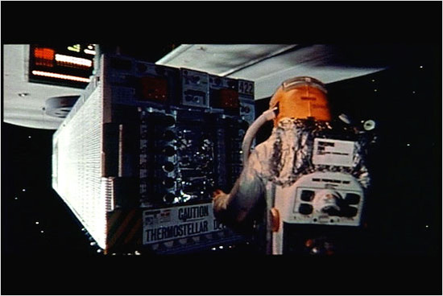

Slide 19
Agent vs. Principal
Principal determines the performance metric hardcoded in the agent
Especially no wireheading allowed for the agent
After acting, the agent cannot simply sit down and declare that all is for the best in the best of all possible worlds
Environment determines the outcome, principal determines its value
Value is expressed as utility, which may not be linear with respect to value, such as with money whose utility is not linear
This can make a difference if the outcomes have uncertainty

Slide 20
Example: Spam Filter Agent
Classic example of a computer agent serving the human principal
Episodic environment where each incoming email is an independent episode
Two possible actions: classify that email as "spam" or "ham"
Four possible outcomes; true and false positives, true and false negatives
Performance measure given as a payoff matrix for the four outcomes
Threshold for sensitivity for discarding the email depends on the relative costs false positives and negatives compared to true classifications
Also depends on actual frequencies of spam and ham emails
Done using Bayesian analysis, to be examined in Module 9

Slide 21
Only the Actions Matter
The principal or the environment do not give the agent an extra cookie for any elegance and extra cleverness shown during the reasoning process
Only the actual achieved outcomes matter; a very pragmatic view of AI
Once the agent has somehow determined that some action A is better than another action B, it doesn't need to know how much better A is than B
Sometimes decision-making can be massively simplified by noting that even though the actual values of actions are unknown, action A is guaranteed to dominate the action B in this sense, so B can be ignored
In that case, no need to estimate value of B

Slide 22
Paperclip Maximizer
Akin to Fantasia, be careful what you wish for, since you might just get it
Machines don't care what you "intend" any more than fire would care that you "intended" to only burn down some weeds, not the entire neighbourhood
AI alignment problem is a wicked problem even to define, let alone solve
General intelligence AI that is given the task of maximizing some particular outcome for perpetuity will inevitably choose actions that keep it functional, for the simple reason that a broken agent cannot maximize anything
These actions include protecting itself against attempts to shut it down
The famous "paperclip maximizer" problem of AI ethics

Slide 23
Actions That Gain Information
Some actions are performed for the information that they reveal
This information can affect the value of future actions
If acquiring this information comes at a cost, it can sometimes pay to be rationally ignorant and not waste time acquiring useless information
Information has value only to the extent that it can change future actions
Unless the new information doesn't actually change the future action you were already planning to do, that information was worthless
Before asking any question from the environment, you should already know what you will do for every possible answer

Slide 24
Module 1b: State Space Search

Slide 25
Models of Environment
Once the agent executes the chosen action in environment, it is committed to that action, and there are no backsies allowed
Agent should create a sufficiently faithful internal model of environment to play around with, and use that model to first explore different possibilities
Abstract away the details that don't affect action selection for agent
State spaces are usually astronomically large, but their structure is regular enough to allow implicit neighbour enumeration of states
State space searching finds the best action sequence in model
Agent prepares a plan of actions to execute in the actual environment

Slide 26
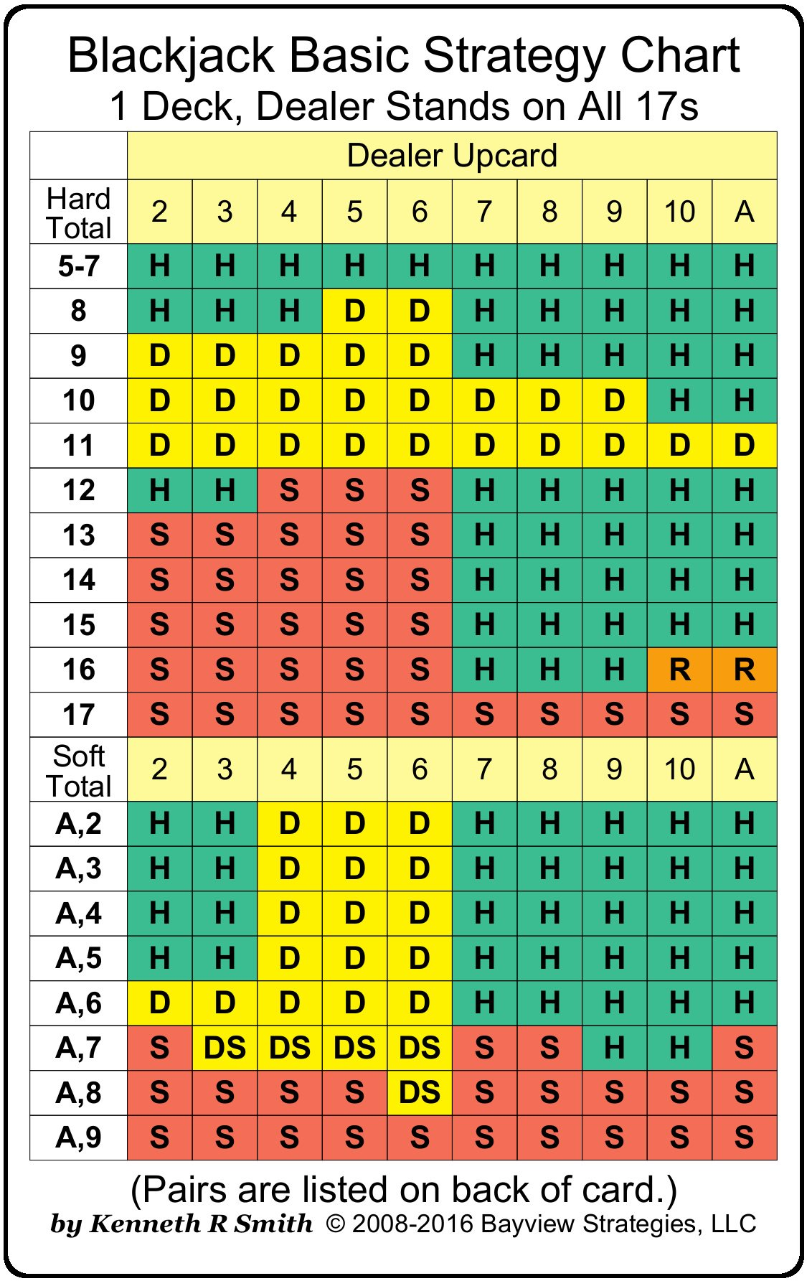
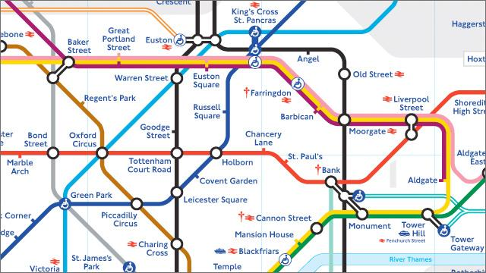
Two Famous State Spaces
Some environments and optimal policies can be expressed quite succinctly

Slide 27
States vs. Nodes
Important the distinguish between states in the state space that models the environment, versus the nodes constructed in the search tree
Nodes correspond to paths in state space from start state to current state
Unless the state space is already a tree, the same state can appear multiple times as search tree nodes
Each node has a well-defined distance from start node
Root node of the tree corresponds to empty path from start state to itself
If some node corresponds to path ɑ in state space, its child node reached with the action a corresponds to path ɑa

Slide 28
Frontier Search
All state space search algorithms are special cases of frontier search
Maintain a queue of active leaf nodes called the frontier
Algorithms pops the next active node from the frontier to expand
Expanding a leaf node adds all its children to the tree and frontier
Algorithm terminates when a goal node is chosen for expansion
Note: when goal node is added as a leaf, can't terminate yet

Slide 29
Other Algorithms As Special Cases of Frontier Search
Breadth-first search: use a FIFO queue as frontier
Depth-first search: use a LIFO stack as frontier
Uniform cost search: use a priority queue as frontier, always expand frontier node s with lowest path cost g(s)
Uniform cost search is special case of Dijkstra's algorithm restricted to operate in a tree, no node can be reached in two different ways
A*: use a priority queue as frontier, always expand frontier node s with lowest heuristic path cost g(s) + h(s)

Slide 30
Markov Property
Environment where only the current situation determines the rational action, but the past history of how you got in that current situation is irrelevant
Future is conditionally independent of the past, given the present
P(Future | Present) = P(Future | Present and Past)
Past cannot affect the future without going through the present
Blackjack: if you currently have a hard 15 against the dealer showing a nine, it doesn't matter whether your cards are 8-7 or K-2-3
If the environment is fully observable, agent doesn't need to maintain history
If environment not fully observable, past state information may reveal some otherwise unseen parts of the current state

Slide 31
Triangle Inequality
In a state space, a black box successor function allows us to move around the state space, but doesn't tell anything about global structure
Global structure of state space that model some real environment will reflect the "laws of nature" of that environment
Especially important is triangle inequality: the shortest path between two points is a straight line, and the space has no "short cuts" between points
The true distance between states A and B is at least as long as the distance between those states "as the crow flies"

Slide 32
Monotonic (Consistent) Heuristic
For the A* algorithm to guarantee finding the shortest path, the heuristic must be admissible so that it never overestimates the true cost to goal
If the heuristic is also monotonic (or consistent), h(u) ≤ c(u, v) + h(v)
Distance to goal cannot decrease more than transition cost
For example, if h(u) = 10 and c(u, v) = 6, then h(v) must be at least 4 (DUCY?)
Note that h(v) = 5 is only a lower bound; could have even h(v) = 1000000
As special case, if h is identically 0, this says that 0 ≤ c(u, v) (Dijkstra)
Using a monotonic heuristic, no node will be expanded more than once during the execution of the A* algorithm

Slide 33
Optimality of A* with Heuristics
If heuristic h₁ dominates heuristic h₂, then the A* algorithm will never expand more nodes when using heuristic h₁ compared to using heuristic h₂
Especially of h gives the distance to the nearest goal perfectly, A* would only expand the nodes actually on the shortest path
Also, a more general result of optimality of A* algorithm itself
A* can be proven to be the best possible algorithm among all possible state space search algorithms, given the same information
Given the same state space information and heuristic function, every search algorithm must expand same nodes as A*, or risk missing the shortest path

Slide 34
Markov Decision Process
What happens if the fully observable Markovian environment is not deterministic, so that actions can have unpredictable consequences?
We are dealing with "known unknowns", instead of "unknown unknowns"
Planning a single action sequence is not enough, unless you get lucky when executing that action sequence in the environment
Need to compute a policy that gives the best action in any state
Since environment is Markovian, history of reaching that state doesn't matter
Techniques for doing this calculation will be examined in Module 12

Slide 35
Module 2: Adversarial Search

Slide 36
Adversarial Search
Search problems become significantly harder when other agents with possibly conflicting interests also get to act in the same environment
The enemy also gets a vote, and no battle plan survives contact with enemy
It is not enough to find shortest path to goal, since adversarial agents will not be co-operative and make the moves that we would like them to make
Instead of NP-complete, search problems become PSPACE-complete

Slide 37
Assumptions for Minimax Search
Exactly two agents try to maximize their own rewards
Zero-sum rewards shared between these two agents
Complete information, deterministic and fully observable environment
Players take alternating turns making moves, and get to see the opponent's chosen move before they commit to their own next chosen moves
Combinatorial game theory is fully solvable in theory, not in practice
General game theory loosens all these assumptions, and needs more general game theoretical analysis that is ad hoc even for seemingly simple games

Slide 38
Components of Minimax Search
The same general purpose minimax search algorithm can play any game
Just have to plug in the following subroutines as black box functions
Move generator: subroutine that produces all possible moves in the given state, along with their successor states
Move generator possibly with local ordering for move quality
Terminal state recognition: recognize that game is over, and return the score
For large game trees, need static estimate of state value, evaluating how good a state is without looking at its successors

Slide 39
Nash Equilibrium
For a large family of "games", every game is guaranteed to have at least one Nash equilibrium strategy that maximizes the expectation for players
Other players deviating from their Nash equilibrium strategies can never harm those players who stick to their own Nash equilibrium strategies
In general games, Nash equilibrium strategies are probabilistic (for example, the game of rock-paper-scissors)
For deterministic observable two-player zero-sum games, Nash equilibrium strategy collapses into a single line called the principal variation

Slide 40
Infinite Move Games Might Not Have Equilibrium
Nash equilibrium can be proven to exist for a large number of systems that we can think of as "games"
Any number of players, uncertainty, makes no difference
If the players can choose from infinite number of moves, Nash equilibrium might not necessarily exist
Consider a game where two players simultaneously say a number, and the larger number wins
No Nash equilibrium can possibly exist, naming n+1 always dominates n

Slide 41
Principle of Indifference
If you are following your Nash equilibrium strategy in any game, opponents deviating from their Nash equilibrium strategies cannot harm you
In fact, you can even honestly announce that you are following your Nash equilibrium strategy, and this information doesn't help the opponents!
You are simply indifferent to what the opponents do, always have a counter
In practical games, either Nash equilibrium strategies are not known, or the players don't have resources to compute and follow these strategies
Trick play: make an intentionally suboptimal move that leads to a complex situation, trusting that weaker opponent does not punish

Slide 42
Partisan and Impartial Games
Some games (for example, nim) are impartial so that on their turn, both players can make the exact same moves
Opposite of partisan games such as checkers, chess and backgammon
Sprague–Grundy theorem: any complete information impartial game is essentially equivalent into a position in the game of nim
Some impartial games (most famously, Chomp) can be proven a win for first player with a nonconstructive strategy stealing argument
If the game were a win for second player, first player starts by making the move that would have been second player's winning response
Effectively "turns the tables" in the game

Slide 43
Playing Against Suboptimal Opponents
Against opponent that deviates from their Nash equilibrium strategy, you may gain more than your fair share by correctly deviating from Nash equilibrium
In rock-paper-scissors, against an opponent who plays the trusty old rock more than 1/3 of his moves, tend to play paper more than 1/3 of your moves
"When playing against an idiot, you must also play like an idiot"
In poker, against player who folds too often, bluff more than optimally
In poker, against a wild bluffer, call liberally and raise conservatively
More players entering the ensuing juicy game between two idiots will then break this balance and force return to normalcy

Slide 44
Negamax
Most material on two-player complete information games makes one player to be maximizer and the other minimizer, as if they were stock characters in some cartoon melodrama
Negamax has both players as symmetric maximizers, each player being the hero of their own story while the other one is a villain
Without moralism, two entities caught in kind of a Sartrean hell chained to each other without recourse to join forces against a sadistic demiurge
"Hell is other agents"

Slide 45
Negascout
Correctness proof of alpha-beta required that the true value of state is between the alpha and beta parameter values at that node
If this is not the case, the search will either fail high or fail low
As noted earlier, once an action A is known to be better than action B, we don't need to waste time computing how much better it is
Idea: evaluate the first move "for realsies", then use null window search to determine if the next move is better or worse
Only if the next move turns out to be better, evaluate it again but for real

Slide 46
MTD(f)
"Memory-Enhanced Test Driver" combined with transposition table
An even better application of alpha-beta pruning discovered in 1994
To compute the minimax value of a move, use only null window searches where ɑ = β, initially some local over/under estimate for move value
Depending on whether search fails high or low, use binary search approach to pinpoint the value of the move
Same as in negascout, can always use best move found so far as ɑ

Slide 47
Transposition Tables
Since the actual state space of the game is not necessarily a tree, same game states can be encountered in several branches of the DFS search tree
If the game is Markovian, these nodes all have the same value
Idea: use a hash transposition table to remember the nodes and their values
Combine this with iterative deepening: use a hash table to remember the best move for each state during iteration of depth limit d, and then try that move first when that same state is encountered during iteration of depth limit d + 1
Want to get those sweet alpha-beta cutoffs as soon as possible

Slide 48
Horizon Effect and Quiescence
Minimax algorithm can look ahead only some fixed number of plies
Some move might look much better than it actually is, because it postpones the inevitable loss that is beyond the lookahead depth horizon
One solution is to extend lookahead depth for positions that are not quiescent, where the static evaluation of value of position differs greatly from the static evaluation of the values of its successor positions
Similar situation of thrashing: if the player has multiple moves leading to win with different depths, should ensure taking the fastest move
Otherwise can get stuck in a "Don't shoot, let's enjoy" situation

Slide 49
Games and Metagames
The microworld of the game is surrounded by some larger reality in which the agents and the game are situated
A zero-sum two player game can be analyzed within that microworld, without having to make any assumptions about the surrounding metagame
Everyone understands that when playing golf or such against your boss or an important client, you might not necessarily be trying your hardest to win
Example of Hanson's razor (not to be confused with Hanlon's razor)
Metagame is important for making the game itself worth playing

Slide 50
Multiplayer games
Some material on minimax algorithm erroneously claims that adding more players to a complete information sequential zero sum game doesn't change the minimax algorithm used to analyze it
"Bu-bu-but each player just gets his turn at that level of recursion, maaan"
Not true: adding a third player creates alliances and kingmaker situations
Such situations can't possibly be analyzed without looking at surrounding metagame, and the future games that these players will be involved in
Under what assumptions would some player betray an alliance?

Slide 51
Nature as Third Player
Nature can be thought of as a player that has no goals or metagame considerations (it always scores zero in the end, no matter what transpires)
Nature especially will never take sides between the actual players
Assuming that the third player is Nature, game can be analyzed within its microworld without having to resort to metagame assumptions
In its turn, Nature makes random moves from some probability distribution
Moves of Nature affect the possible moves and outcomes of actual players
Randomness in general tends to help the weaker player (consider chess vs. heads-up no limit Texas hold'em poker)

Slide 52
Expectimax
Random moves make search tree branch massively sideways
Furthermore, value of state is no longer a single number, but a probability distribution, and unlike numbers, those are not totally ordered
To allow comparison of moves, collapse each distribution to its mean
Expectimax as generalization of minimax algorithm
Analysis requires utilities of outcomes to be linear, which is not the case with money once the stakes get sufficiently high
When playing for money, two distributions can have the same expected value, yet have massively different expected utility

Slide 53
Nonzero Sum Games
How does analysis change if the outcomes for players are not zero sum?
Game could have partially adversarial and partially co-operative aspects, depending on the structure of its state space
Again, such games cannot be analyzed within the microworld of a single game, but the surrounding metagame needs to be taken into consideration
Future games and reputation determine whether an agent should take a trust fall in the current match so that both agents to score better, if the other agent can betray them to grab all the moolah

Slide 54
Cooperative Games
Game theory covers even fully cooperative games where an agent can never gain by making another agent worse off
For example, all agents will get the same score in the end, and should therefore work as a team to reach this shared common goal
To make such game interesting, environment isn't fully observable
Agents are not allowed to use back channel communications, but must communicate and coordinate within the physics of the environment
Actions have a component of communication in addition to actually achieving the desired outcomes in the environment itself

Slide 55
Games of Incomplete Information
Unlike chess or backgammon, most card games don't allow players to observe the entire current state of the game
State space search with minimax doesn't work
Even for one player, such a system becomes a partially observable Markov decision process (POMDP), already a complex problem on its own
For multiple adversarial players, the problem is highly nontrivial
Best computer players for poker and bridge do not dominate humans the same way as best chess and Go computers players do these days

Slide 56
Games With Simultaneous Moves
Minimax algorithm assumes a sequential game of alternating turns, so players don't have to commit to moves until they have seen the opponent's move
Rock-paper-scissors as a sequential game would be pretty boring
Single-shot game (e.g. soccer penalty shoot) analyzed as a table whose rows and columns are the possible moves of both players
Nash equilibrium strategy no longer a deterministic principal variation line, but a probability distribution of moves for each player
Players choose their probability distributions, after which the outcome is out of their hands after they have rolled the random dice to make the actual move
"Pre-game is the real game", as the famous expression goes

Slide 57
Module 3: Constraint Satisfaction

Slide 58
Local Constraints, Global Effect
Each individual constraint connects together only a handful of variables
Because the same variable can occur in multiple constraints, these constraints create a complex network of dependencies and implications
Each individual constraint is simple, yet the resulting network is complex!
Even if each variable is a boolean truth value, and every constraint is a disjunction of these variables and their literals, any computational problem whose running time has a known upper limit can be encoded into a constraint satisfaction problem of this form
The famous 3-CNF-SAT problem is NP-complete

Slide 59
Race Against The Hydra
Recall that running time of depth-first search is O(b^{d})
Since d is same for all CSP branches, we can't do anything about it, so the branching factor b determines the maximum running time of the algorithm
Efficiency of backtracking greatly depends on current variable selection
Good choice for current variable eliminates remaining values from as many unassigned variables as possible, lowering b down the line
As we explore the tree, nodes try to branch sideways exponentially
The recursion is a race between these heads of the hydra and the assignments to current variables to chop off future heads

Slide 60
Minimum Remaining Values
Given a choice of which unassigned variable to fill in next, we choose the unassigned variable with the lowest remaining b
Best case scenario is that the chosen variable has only one remaining value after the previous assignments, making that level essentially a "bye" for us in an upside-down cup tournament
Since we have to fill in every variable anyway, we can't possibly save time by postponing the assignment to that variable to be done later
Besides, assigning that variable now eliminates possible values from other unassigned variables that appear in same constraints

Slide 61
Accept the Things You Cannot Change…
It seems counterintuitive to look for reasons to turn back as soon as possible, as if we were trying to fail instead of trying to complete the solution
However, if the current partial assignment has already painted us in a corner so that no solutions can be extended from it, nothing we do can change that
When going the wrong way, it's always better to turn back sooner than later!
If the partial assignment is bad, we want to know this as soon as possible
Knowing that the current partial assignment will lead to a legal solution would not help us anyway, since this knowledge doesn't change any of the steps that we will take completing that branch!

Slide 62
Auxiliary Data Structures
During the partial assignment of variables, it is often beneficial to maintain some auxiliary data structure, shared by all levels of backtracking recursion
This auxiliary data structure speeds up finding the next variable to assign, and iterating through its possible values that don't violate constraints
For example, in n-queens problem, maintain three bit vectors that keep track of rows, diagonals and anti-diagonals have already been taken
Turn O(n) check into O(1) check, an order of magnitude speedup
In a sense this auxiliary data structure is redundant, since its contents are entailed by the partial assignment of variables performed so far
Trading small extra memory for lots of time is a good trade

Slide 63
Updating and Downdating Auxiliary Data Structure
For each assignment of the next unassigned variable, this auxiliary data structure must be updated to reflect the new reality of partial assignment
Once the recursive filling of rest of the variables returns and that variable is unassigned again, the data structure must be downdated to its previous state
Often this is just inverse of the updating statements, but not always
A shared (global) undo stack is a general technique that always works
During update after variable assignments, push into undo stack the instructions required to reverse that update, somehow encoded to ints
After unassigning that variable again, pop and execute those instructions

Slide 64
Dancing Links
For problems that fill an array with some permutation of values from 0 to n–1, the Dancing Links technique by Donald Knuth allows the remaining values for the current variable updated, downdated and iterated over efficiently
Initially, all the values 0 to n–1 are arranged in a cyclic, doubly linked list with an extra sentinel node, as two (n+1)-element arrays prev and next
When value i is assigned to current variable, it is O(1) removed from this list
Genius flash of insight: when that variable is unassigned, node i can be restored back to its previous location in O(1) time!
Iterating over the m values for current variable takes O(m)

Slide 65
Backtracking Without Recursion
Real world instances of CSP's can these days have hundreds of thousands of variables and constraints
Recursive backtracking algorithm will surely die with a stack overflow
Backtracking can be implemented non-recursively as a single while-loop, easiest to explain assuming variable array is filled left to right
The loop keeps track of the variable k that it is currently at, initially 0
If variable k has possible values remaining, assign first value and increment k
Otherwise, unassign and decrement k to go back to previous variable
When k = d so that all variables have been filled, yield the current solution
Easy to go do something else, and then continue generating more solutions

Slide 66
Search Problems With Cost Functions
Constraint satisfaction problems can be generalized by finding a solution that not just satisfies the constraints, but optimizes the given cost function
CSP's trivial special case of this with cost function 0 for legal solutions
More nuanced cost function counts how many constraints are violated
Iterative improvement algorithms maintain one complete variable assignment at the time, and always change individual variable values
Min-conflicts: As long as some constraint is violated, reassign some variable so that the constraint becomes satisfied

Slide 67
Tabu Search
An improvement of hill climbing to prevent getting stuck in local maxima
Maintain a tabu list of k most recently visited positions
Same as hill climbing, always move to the neighbouring position with the highest value, except that the algorithm is not allowed to move to any position in the tabu list
Even a move to a lower-value neighbour position is allowed, if no better position in the tabu list is available
Generalization by having multiple searches going on simultaneously, trying to hill climb while avoiding each other

Slide 68
Genetic Algorithms
Technique for optimization problems where each variable assignment is legal, but their costs are different
Maintain a population of solution candidates, called a generation
Use each generation to produce the next generation of solutions
Repeatedly choose two solutions from the current generation, somehow statistically favouring solutions that have a higher fitness
Combine these two solutions with crossover to create two new solutions
Possibly mutate individual variables randomly with small probability
Iterate new populations until "good enough" solution appears

Slide 69
Building Block Lemma
"No Free Lunch" theorem of search algorithms says that over all possible search problems, every search algorithm is equally good
Should use a search algorithm that "fits" the underlying fitness landscape in that its moves correctly towards optimal solutions based on the information that it gets from current solution
Genetic algorithms work for problems that have a "building block" property: solutions with given partial building block are better than average
Search will direct towards creating and maintaining these building blocks

Slide 70
Variations of Genetic Algorithm
Instead of normal one-point crossover to combine two solutions, use two-point, three-point, or higher crossover
Variations of crossover to maintain legality of solutions in problems such as travelling salesman
Elitism copies the k best solutions of current generation to next
If the cost function isn't explicit, but it's possible to compare two solutions, can use tournament selection (akin to a cup tournament)
Can maintain multiple populations and evaluate them in parallel, with occasional migration of best solutions

Slide 71
Genetic Programming
Generalization of genetic algorithm so that the solutions are programs
Suitable for problems for which no analytical solution is known
Fitness of a program is measured by giving it a bunch of test cases with known expected correct solutions, and measuring the error of the answers produced by this program over the entire test suite
To make crossover possible, solutions are expressed as parse trees
Crossover of two solutions swaps random subtrees from both parents
Mutation replaces randomly chosen subtree with a random subtree

Slide 72
Modules 4 to 6: Prolog

Slide 73
Prolog, As Seen By ChatGPT...
Prolog, a language like no other,
Declarative, with rules to discover.
With facts and queries, it leads the way,
Finding solutions, in an efficient way.
It's logic-based, a different view,
Thinking in predicates, it's easy to do.
A symbol of reason, and smart design,
Coding with Prolog, a new paradigm.
You state the facts, and it will reason,
With rules and queries, it's the right season.
To build knowledge bases, and solve problems too,
Prolog is the language, to see it all through.
So let us praise, this language of art,
For making our work, so smart.
A language that's unique, and worth exploring,
Prolog, a language, always adoring.

Slide 74
I Have Seen The Future And It Forks
"A language that doesn't affect the way you think about programming, is not worth knowing." (Alan Perlis)
"Prolog is so simple that one has the sense that sooner or later someone had to discover it. Why did we discover it rather than anyone else?" (Alain Colmerauer)
"I used Prolog in a comparative languages course. The biggest program we did was a map-coloring one (color a map with only four colors so that no bordering items have the same color, given a mapping of things that border each other). I say biggest because we were given the most time with it. I started out like most people in my class trying to hack the language into letting me code a stinking algorithm to color a stinking map. Then I wrote a test function to check if the map was colored and, in a flash of prolog, realized that that was really all I needed to code."

Slide 75
Prolog Terms
The basic syntactic unit of Prolog programs is a term (an expression)
Structure of legal terms is defined recursively
Base cases of recursion are constant and symbolic literals, and variables
Symbolic literals start with lowercase, variable names start with uppercase
42 and "joe" are constant literals, male and joe symbolic, Joe is variable
Symbolic literals are not text strings, but an entirely different thing!
More complex terms can be built from applying a functor to arguments
Functor is always a symbolic literal, but its arguments can be any terms
male(joe) is a complex term, as is foo(qux/"hello", 42+X/9)

Slide 76
Infix and Prefix Notation
Every complex Prolog term is in the prefix form functor(args)
However, for convenience for us humans, many functors allow infix form where the functor is syntactically between the two arguments
For example, we write joe * (7 + X) instead of *(joe, +(7, X))
Both forms become equivalent expression trees when parsed, and work exactly the same as far as computations are concerned
Especially comma operator looks nicer as a, b, c than ,(a, ,(b, c))

Slide 77
Homoiconicity
Other languages that you have seen so far in your computer science studies make a hard distinction between code and data inside that language
Code cannot be assigned to variables, data cannot be executed
Prolog is homoiconic in that its code and data are literally the same thing!
Prolog code consists of terms, and so does its data
Complex data in Prolog is essentially untyped, but for complex terms, the functor symbol can be thought of as "type" of that data
All code can be treated as data and all data can be executed as code, for flexibility that ordinary languages cannot begin to imagine

Slide 78
Bound and Unbound Variables
All Prolog variables are untyped, and start as being unbound (free)
During execution of a query, a variable can become bound to some term
In computer memory, each variable is stored as a pointer
Unbound variables are null pointers
Binding a variable to a term assigns that variable pointer to point to the root node of the expression tree that represents that term in memory
All variables are final: a bound variable cannot be bound to something else
(Execution backtracking will unbind variables on the way back)

Slide 79
Prolog Predicates
Interpreted as code, a Prolog term can be used to define a predicate
Each predicate represents some kind of relation between the entities that exist in the problem domain
Since all Prolog data consists of untyped terms, predicate signature consists of the functor symbol followed by the arity of that predicate
For example, predicate male/1 defines the concept of "maleness"
In predicate logic, each predicate is true or false for the given arguments
Formulas in the given Prolog program determine for which arguments the given predicate is true, that is, the query succeeds

Slide 80
Predicate Definitions With Rules
In a Prolog program, a predicate is defined with one or more rules whose left hand side (head) is some term whose functor is that predicate
The right hand side (body) after the :- delimiter is a comma-separated list of the sufficient premises for that predicate to be true, followed by a period
Comma in Prolog stands for logical and between these premises
The right hand side can also be empty, meaning that the predicate is true unconditionally for its arguments
Predicate rules can contain variables, meaning that that predicate is true for any possible instantiation of those variables to any terms

Slide 81
Anonymous Variables
If the same variable name appears multiple times inside the same rule, it will refer to the same variable in all its occurrences
Essentially require that same value must be used in both places
Some variable might appear only once inside some rule
Effectively, values of such variables do not affect the success of that query
Such anonymous variables should be named with a single underscore _
(Read this underscore symbol out loud as "anything" or "whatever")
Multiple anonymous variables inside the same rule are separate variables

Slide 82
Prolog Queries
Execution of a Prolog program starts with a top-level query to solve
To solve each individual term in the top-level query, Prolog goes through all the rules whose LHS is the same functor
If the arguments unify with possibly some variable instantiations, Prolog will try to recursively solve the queries in the RHS of that rule
These may in turn trigger further recursive queries of arbitrary depth
Once all queries have been solved, query is successful, otherwise it fails
When the top-level query is successful, Prolog echoes its variable bindings, and pauses to ask if the user wants more solutions

Slide 83
Negation as Failure
Prolog is a very limited special case of predicate logic, yet Turing-complete
Prolog rules are Horn clauses: a conjunction of positive premise literals together entail the positive literal at the head of the rule
Predicate rules cannot contain negative requirements
Closed-world assumption: in the world that the predicates talk about, only those relations hold that can be proven using the rules of the program
If the query male(q8x7) fails, q8x7 is not a male in that world

Slide 84
Predicates Represent Relations
Prolog predicates are not functions, they do not "return" any values!
Predicates represent relations, whose trivial special case functions are
Beware the common beginner mistake by making a query X = parent(bob)
This is still a legal query, but probably not what was intended!
The intended query parent(X, bob) either succeeds or fails
When some query succeeds, it binds the free variables X and Y into terms for which the query is successful
Query X = parent(bob) succeeds by binding variable X to parent(bob)

Slide 85
Determinism and Nondeterminism
In Prolog terminology, a predicate can be deterministic, semideterministic or nondeterministic, depending on how many times same query can succeed
Deterministic predicates succeed exactly once, regardless of arguments
For example, system predicates such as writeln/1
Semideterministic predicates either fail or succeed exactly once
Nondeterministic predicates can succeed any number of times (incl. zero)
Some nondeterministic predicates even allow infinitely many solutions
Depending on the predicate definition, Prolog may be able to generate all these solutions, especially if they form a nice linear infinity

Slide 86
Execution Backtracking
When a nondeterministic query succeeds, it may leave behind a choice point
The Prolog interpreter remembers all choice points left behind in execution
When some later query fails, program execution backtracks all the way to the most recent choice point that was left behind
During backtracking, all variables that were bound when the execution was going to forward direction become unbound again
Execution then continues forward from the choice point, allowing these variables to again become bound to some other terms

Slide 87
If At First You Fail...
Failure of a Prolog query should not be confused with errors and exceptions in imperative languages such as Java or Python
Failure doesn't mean that anything is "wrong" with your program or its data, but failures are necessary to prevent the Prolog execution from embarking in a fruitless infinite branch down the implicit search tree
Think of the failure of a query as a friendly angel that tells you truthfully that there is nothing for you where you are trying to go, and therefore you should turn back now and try the next branch from the most recent choice point

Slide 88
Generate All Solutions Exactly Once
When defining rules for some given predicate, your rules should be designed to produce every solution to each legal query exactly once
Furthermore, once the last solution to the query has been found, there should not be any redundant choice points left behind
Ideally, predicates should be maximally reversible and generative so that the query can leave as many arguments unbound as they want, and the rules will still generate all possible solutions exactly once
Realities of computation sometimes prevent this, even with seemingly simple basic integer arithmetic

Slide 89
Order of Rules Inside Program
Prolog differs from predicate logic in that how you order of rules with the same head functor inside the Prolog program can have consequences
Obviously, affects order in which individual solutions are found
For predicates with infinitely many solutions defined recursively, you should place the rules for the base case before the general case
Otherwise backtracking dives into infinite branch and produces nothing, instead of producing the linear chain of solutions one at the time
Ordering of rules becomes especially important with cuts seen later

Slide 90
Order of Premises Inside Rules
Prolog also differs from predicate logic in the behaviour of its inference engine so that order of premises inside the rule body is important
Ordering of premises can affect termination properties of queries
As in all programming, especially should avoid left recursion
Even with terminating queries, rule ordering can affect efficiency
Classic example of finding the first lady of the nation: firstlady(X) :- female(X), married(X, Y), president(Y). firstlady(X) :- president(Y), married(X, Y), female(X).

Slide 91
Unification (I)
When going through the rules that would allow the query to succeed, that query must unify with the head of that rule for the rule to be used
Unification is a recursive algorithm that operates on pointers to expression trees that represent the terms, no string matching or such is involved
Both sides of unification can be arbitrary complex terms
An unbound variable unifies with any term, binding that variable to that term
Two literals unify if and only if they are the exact same literal
Two complex terms unify if and only if they have the exact same head, and their arguments unify pairwise

Slide 92
Unification (II)
To unify two terms, the algorithm finds the most general unifier (MGU)
MGU makes minimum commitment to variable bindings to allow unification
Unification predicate =/2 has been proven to be semideterministic: two terms either do not unify, or their MGU is unique (modulo variable names)
In 99% of real use cases, using the predicate =/2 explicitly in Prolog rules is correct but clumsy: move the unification action to matching of rule head
Predicate \= succeeds if the two terms do not unify
This predicate can be defined since =/2 is semideterministic

Slide 93
Unification With Occurs Check
What if the same variable occurs on both sides of the unification?
Unification can create an infinite result, such as in the query X = f(X).
Solution would be infinite term f(f(f(...)))
Encoded with pointers, the result expression tree contains a loop
Prolog term echo mechanism fortunately recognizes this situation
Unification algorithm does not perform the occurrence check, since it would turn O(n) algorithm into O(n²) algorithm, hindering performance for no reason
Logically sound unification with predicate unify_with_occurs_check/2

Slide 94
Unification With Forced Evaluation
Prolog variables can be bound to arbitrarily complex terms
Prolog will never try to simplify these terms until you explicitly order it to do that by using the predicate is/2
is/2 is used otherwise like =/2, except that is/2 will first evaluate the right hand side before attempting to unify both sides
Closest thing to assignment of imperative languages in Prolog
Right hand side must be in a form that allows evaluation, otherwise the entire query will crash with an error
Arithmetic equality =:=/2 evaluates both sides before unify

Slide 95
Reversibility
In imperative languages such as Python or Java, each function/method call produces exactly one result
This result may be an aggregate object, but you get only one
Imperative functions cannot be executed in reverse so that you give them expected results, and they would return arguments to produce those results!
Prolog predicates don't make any distinction between their "arguments" and "results", but are fully reversible, assuming that their rules don't contain any predicates defined "one-way" for efficiency reasons
For example, integer multiplication and is/2 are one-way

Slide 96
Unbound Queries and Results
Some predicates require that some of their arguments must be bound to certain types of terms for the query to succeed
For example, predicate between/3, closest thing to for-loop in Prolog
The query between(1, 10, X) succeeds for all integer values X that are between 1 and 10, inclusive
First two arguments must be bound to integer values at time of query
Even though queries such as between(2, X, 6) would make sense (though with a linear infinity of solutions), implementation does not allow this
Gold standard is to allow any and all arguments to be unbound

Slide 97
Lists
Prolog does not use random access arrays for aggregate data, since these don't work well with notion of immutable data
Prolog aggregate data type is a list that is either empty, or consists of a head element followed by the tail of the rest of the elements
Easy to add or remove an element to the front, not to the end!
Syntactic sugar allows [[42], foo(bar/7), X, bob(bob(bob)))]
Head is the first element, and can be any Prolog term
Tail is the list of remaining elements, must always be a list
In a singleton list such as [42], tail is the empty list

Slide 98
Lists and Unification
Many list predicates are defined with recursive rules whose behaviour depends on the head and the tail of the list argument
Term [H | T] unifies with any list whose head is H and tail is T
For example, [H | T] = [1, 2, 3] succeeds with H = 1 and T = [2, 3]
Term [H | T] does not unify with the empty list []
Note important difference between [H | T] and [H, T], the latter unifying only with lists that have exactly two elements, no more and no less

Slide 99
Appending Two Lists
List predicate append/3 is very useful in defining other list predicates
Fully generative and reversible: append(L1, L2, [1, 2, 3, 4, 5]) produces all six different results
Even the query append(L1, L2, L3) produces all solutions
Rules for prefix/2 and suffix/2 become one-liners
When building rules for other predicates with append/3, note that running time of append is linear to the length of the first list
Often more efficient to build lists recursively by adding new items to head

Slide 100
Introspective Predicates
Some system predicates inspect the current state of the Prolog computation
For example, statistics/2 can be used to gauge various metrics
Important family of introspective predicates determines the type of term that a particular variable is currently bound to, or whether it is unbound
Such predicates help define predicates that are more reversible
For example, predicate plus/3 to replace the + operator
Depending on which one of the three parameters is unbound, the queries plus(1, 2, X), plus(1, X, 3) and plus(X, 2, 3) all work correctly
(Hard exercise: define my_plus/3 to allow any two arguments unbound)

Slide 101
Cuts
The only control structure in Prolog is the cut, denoted by !
Prolog is Turing-complete even without the cut, but cuts can simplify code
Cut is a deterministic predicate that always succeeds, executed for its side effect of cutting away all choice points in the current query
Cut doesn't reach up to the queries above the current query
Cut would perhaps better be called "commit", since it commits to the current branch in the search tree and ignores the solutions found by branches hanging from the choice points of the current query

Slide 102
If-Else Implemented As Cut-Fail
How to simulate the if-else structure of imperative programming languages so that precisely one of the branches will be executed?
Standard solution using cut-fail: write two versions of the rule
Body of the first rule starts with the condition to be tested
If the condition is true, do a cut to prevent second rule to be executed for the current query, and follow the cut with the positive branch of if-else
The second rule should unconditionally just execute the negative branch
The fact that execution gets to the second rule means that the condition is false, since otherwise cut would have taken effect

Slide 103
Red Cuts and Green Cuts
In Prolog terminology, a green cut is one that doesn't eliminate any solutions
Rules with the green cuts have the same solutions as they would without the green cut, but produce these results faster and possibly without repetitions
Especially avoid the cardinal sin of Prolog rules, leaving a redundant choice point that we can reason from outside that cannot lead anywhere
A red cut eliminates some solutions that predicate would have without it
Recall the gold standard of making predicates maximally reversible by allowing any and all of their arguments to be unbound variables
Adding cuts to predicate rules goes against this noble goal

Slide 104
Using Terms as Queries
Noble attempt for a query: X = male(bob), X.
Unfortunately, this doesn't work: query can't syntactically be a variable
Need to use the metapredicate call/1 that executes its argument as query
Better: X = male(bob), call(X).
Multiple versions of call allow more arguments to be added to query
X = male, call(X, bob)
Note also call_with_depth_limit/2 for potentially executing queries in iterative deepening fashion

Slide 105
Prolog Negation
Prolog does have a metapredicate not/1, but this should not be confused with actual logical negation, since Prolog only deals with positive terms
Negation as failure with closed world assumption: precisely those things are true that can be proven to be true
The query not(Q) succeeds if and only if Q itself would fail without solution
Easy definition using cut-fail to simulate if-else: not(Q) :- call(Q), !, fail. not(_).
Riddle me this: how are Q and not(not(Q)) different?

Slide 106
Finding All Solutions To Query In One Swoop
For a nondeterministic query, Prolog produces solutions one at the time
Since there could be exponentially of solutions (for example, consider the list predicate permutation/2), we don't want to run out of memory
Handy metapredicate findall/3 generates the list of all solutions for the given query, listed in the order in which the query would produce them
For example, findall(Y, (between(-3, 3, X), Y is X*X), L) would succeed with L = [9, 4, 1, 0, 1, 4, 9]
Note the use of parentheses to disambiguate between comma denoting the logical and, versus comma used as argument separator

Slide 107
Ordinary Recursion in Java
public int factorial(int n) { if(n < 2) { return 1; } else { return n * factorial(n-1); } }
The recursive call in the second line of this method is not tail recursive, since multiplication takes place after the recursive call
Need one stack frame per recursion level, since the method needs to remember the current value of n at each recursion level

Slide 108
Tail Recursion in Java
Introduce an extra accumulator parameter to enable tail recursion
public int factorial(int n) { return factorial(n, 1); }
private int factorial(int n, int acc) { if(n < 2) { return acc; } return factorial(n-1, acc*n); }

Slide 109
Tail Recursion in Prolog
Prolog rule is tail recursive, if the recursive query of that same predicate is the last term in the body of the rule, and all previous terms in the rule are (semi)deterministic so that they can't leave any choice points behind them
Same as in imperative languages, Prolog can recycle the current stack frame
Converting predicate to tail recursion a mechanistic 3-step process
Step 1: Have the predicate call extended predicate with state arguments
Step 2: Rule for base case to unify result variable
Step 3: For general case, calculate the new state arguments from previous, and finish with tail recursive call to go to the next round

Slide 110
Simulating Structured Data Types In Prolog
Prolog has only one universal data type, the Prolog term
We can simulate structured data types of other languages by defining that data type to be any term with the given functor
Arguments of term give the field values for that structured data object
Since data is immutable, rules on such terms must determine the effect of applying some mutation operator to the term to produce a new term
New and old term share as many subterms as possible
See the examples bankaccount.pl and bst.pl to illustrate this principle

Slide 111
Constraint Logic Programming
Ordinary Prolog variables are either unbound, or bound to a term
Represented in memory as pointers, null pointer for unbound variable
Forces the programmer to arrange rule logic so that variables will be bound to concrete integer values before any arithmetic is performed on them
Not as flexible as logic programming could theoretically be, we want more!
Constraint logic programming standard library extension allows a set of lazy constraints to be attached to each variable
When top-level query succeeds, lazy constraints are echoed

Slide 112
Constraint Logic Programming Operators
Equality constraint #= is symmetric between LHS and RHS and subsumes operations is and =:=, internally reduces to these whenever possible
For other arithmetic comparisons, lazy constraints #<, #>= etc.
Lazy constraints are automatically propagated during program execution, and trigger backtracking as soon as they become impossible to satisfy
Predicates indomain/1 and labelling/2 can be used to iterate through all possible values of lazily constrained variables, essentially turning these variables back into ordinary Prolog variables when needed
Require the constrained domain to be finite, though

Slide 113
A Limerick About Prolog, As Written by ChatGPT
There once was a language called Prolog,
Its rules and queries, oh so cogent.
It made programmers shout,
"This language is what it's about!"
A joy to code with, no need to cogitate.

Slide 114
Module 7: Propositional Logic

Slide 115
Implicit and Explicit Truths
State space techniques generally require environment to be fully observable
State space techniques cannot directly utilize known laws of environment
Agent's actions are affected by reality of the environment
Reality consists of explicit (directly observable) parts and implicit parts
Implicit truths are still just as "real" as explicit truths, in that they have real effects on the consequences of different actions
Implicit truths must be reasoned from the observed explicit truths, aided with the "laws of nature" of the environment that bind these together

Slide 116
Formal Reasoning
Mechanistic inference engines perform logical reasoning based solely on the form of the sentences, without appealing to any ideas about objects that the symbols in these sentences happen to refer to
Especially rewriting the symbols of a sentence does not change any formal properties of that sentence that could affect mechanistic inference
If you agree that sentences "All men are mortal" and "Socrates is a man" entail the sentence "Socrates is mortal", then you should agree that the sentences "All foo are bar" and "Xyb123 is foo" entail "Xyb123 is bar"

Slide 117
Worlds and Models
A logical sentence is not "true" or "false" by itself, but relative to given world
The same sentence can be true in one world and false in another world
A world in which given set of sentences is true is called a model for that set
Sentence that is false in every world is a contradiction
Sentence that is true in every world is valid (tautology)
Sentences ɸ and ψ are consistent if ɸ ⋀ ψ is not a contradiction
Note that the sentence "2 + 2 = 4" is not a tautology, but depends on the meaning of the symbols 2, + and 4 in that world
Sentence "2 + 2 = 2 + 2" is tautology (meaning of = is fixed)

Slide 118
Do Not Confuse These Three
Entailment ɸ ⊨ ψ: In every world where ɸ is true, so is also ψ
Entailment looks at semantics and worlds from "God's eye" view
Inference ɸ ⊢ ψ: Given formula ɸ as input, mindless machine doing inference can spit out the formula ψ as output
Inference looks at what we can program a computational device to do
Implication ɸ ⇒ ψ: Express the notion of "If ɸ, then ψ" as a sentence stated inside the logic itself
Implication is intuitive syntactic sugar for sentence not-ɸ ∨ ψ
Do not hallucinate a causal relationship between ɸ and ψ

Slide 119
Carroll's Paradox of Finite Inference
Suppose Joe Palooka accepts the sentences "A" and "If A, then Z" as being true, but still doesn't accept the sentence "Z" as true
How would you convince Joe that he must accept also sentence "Z" ?
Whatever you now say, call that sentence B
Joe says that he accepts the sentences "A" and "If A, then Z" and your B as being true, but still doesn't accept the sentence "Z" as true
How would you convince Joe that he must accept also sentence "Z" ?
Whatever you now say, call that sentence C, and repeat
Rules of inference can't themselves be logic sentences
Otherwise we will get turtles all the way down

Slide 120
Bivalence
Bivalence is a semantic property of logic in that every sentence is either true or false in the given world, there is no third alternative
Hold for propositional and predicate logic: Exactly one of the formulas ɸ and not-ɸ is true in the given world, by definition
Does not hold for three– or multivalued logics, especially fuzzy logic
In Bayesian probability, formula ɸ is either true or false in the given world, but our degree of belief in it can vary in range [0, 1]

Slide 121
Law of Excluded Middle
Law of Excluded Middle is often confused with bivalence
A syntactic property of logic, not semantic property!
Any formula of form ɸ ∨ not-ɸ is true in every world by virtue of its form
Need to be able to determine if two formulas ɸ and ψ are logically equivalent to determine if formula ɸ ∨ not-ψ is valid
Holds for propositional and predicate logics, and Bayesian probabilities
May or may not hold for three-valued logics with truth value "undetermined", depending on whether this is ontological or epistemological
Does not hold for fuzzy logics

Slide 122
Truth Functionality
Logic is said to be truth functional or compositional if the truth value of a formula is fully determined by the truth values of its subformulas
Holds for propositional and predicate logic
Does not hold for Bayesian probabilities: Even if you know that P(A) = 0.2 and P(B) = 0.5, you don't know the probabilities P(A ∨ B) or P(A ⋀ B) from these
Does not hold for higher-order modal logics that use operators such as "knows" or "believes" or "sometimes" or "always"
"Lois Lane knows that Superman can fly" and "Clark Kent is Superman" do not entail the sentence "Lois Lane knows that Clark Kent can fly"

Slide 123
Properties of Inference Engine
Monotonicity: Adding new sentences to knowledge base can never decrease the set of sentences that can be soundly inferred from it
Locality: Inference rules can be soundly applied to a subset of sentences, without having to care about the rest of the knowledge base
Detachment: After a new sentence has been inferred, steps of its inference do not affect future inferences made using that new sentence
Principle of explosion: From a knowledge base that contains both sentences ɸ and not-ɸ, any sentence whatsoever can be inferred

Slide 124
Fuzzy Logic
Modelling reality as shades of gray instead of binary black and white
Not to be confused with Bayesian probabilities where bivalent reality is still black and white, we merely have varying degrees of belief about its aspects
In fuzzy logic, the facts themselves in the world are gray, and each proposition A that refers to them gets a truth value μ(A) in [0, 1]
Might actually be more appropriately called "logic of fuzziness"
Unlike probabilities, fuzzy logic is truth functional
μ(A ⋀ B) = min(μ(A), μ(B)), μ(A ∨ B) = max(μ(A), μ(B)), μ(not-A) = 1 – μ(A)
Smoother inferences for reasoning about the world, smooth control

Slide 125
Disjunctive Normal Form and Horn Clauses
Conjunctive normal form is implicative normal form rewritten using ∨
(A ∨ not-B ∨ not-C ∨ D) is the same formula as (B ⋀ C ⇒ A ∨ D)
Formula in a disjunctive normal form is said to be in Horn form if its every clause contains at most one positive literal
Bunch of positive premises imply exactly one positive conclusion
Inference algorithms for Horn clauses are simpler than algorithms for general clauses, since there is no branching for conclusion
Modus Ponens is complete reasoning algorithm for Horn clauses, using either forward chaining or backwards chaining

Slide 126
Tseytin Transformation
Due to use of distributive laws, conversion from arbitrary propositional logic to 3-CNF seen in AIMA slides can blow up the formulas exponentially in size
Alternative technique of Tseytin transformation avoids exponential blowup by creating more propositional symbols for subformulas
Identify every subformula in knowledge base that is not a literal, and create a new proposition symbol for that subformula
Rewrite all formulas using new proposition symbols for subformulas
Convert new clauses into disjunctions by replacing equivalence and implication with equivalent disjunctive structures

Slide 127
Converting from CNF to 3-CNF
Conversion from propositional logic formulas to CNF as seen in AIMA notes is usually continued with an extra step that guarantees that each clause contains at most three literals (handy for many later conversions)
If a clause ɸ has four or more literals, split ɸ in half into clauses ɸ₁ and ɸ₂
Create a new proposition symbol Z that does not appear in clauses so far
Replace the clause ɸ with two clauses (Z ∨ ɸ₁) ⋀ (not-Z ∨ ɸ₂)
To make both new clauses true, at least one literal in ɸ must be true
Repeat until each clause has at most three literals
New knowledge base is satisfiable iff the original is satisfiable

Slide 128
Resolution Refutation
Resolution rule is sound, but is not strong enough to produce all sentences entailed by the given knowledge base
For example, can't produce P ∨ Q from the knowledge base P ⋀ Q
To prove that ɸ ⊨ ψ, show that (ɸ ⋀ not-ψ) is inconsistent
Proof by contradiction by deriving empty clause
Resolution refutation is complete for propositional logic
Since there can exist at most 3^{n} clauses for n propositional symbols (DUCY?), algorithm will return positive or negative answer in finite time

Slide 129
Converting Other Problems To Propositional Logic
In theory of computation, Cook's theorem proves that any decision and search problem from the class NP (non-deterministic polynomial time) can always be converted into a set of equivalent propositional logic formulas
Propositions correspond to variables of the original problem, clauses correspond to constraints for values of these variables
Multivalued variables broken into unary or binary representation
The original decision problem has a solution iff this formula is satisfiable
Solution to the original problem can be read from the satisfying assignment of truth values to propositions in the satisfiability problem

Slide 130
Example: Graph Colouring
Consider the problem of colouring a graph with n nodes with k colours
Create nk separate propositions C_{ij} to mean "Node i has colour j"
Seems inefficient, but bear with us for a moment
For each node i, create the clause (C_{i1} ∨ ... ∨ C_{ik})
Each node must have at least one colour
(We don't need to say that each node has exactly one colour. DUCY?)
For each edge (u, v) and every colour c, create clause (C_{uc} ⇒ not–C_{vc}) so that nodes connected by an edge can't share colour

Slide 131
Example: Sudoku Solver
Sudoku is just graph colouring in disguise, cells are nodes and k = 9
Two cells are connected by an edge if they are in the same row, in the same column, or in the same box
Some cells have been given a fixed colour in the beginning
Problems intentionally designed so that satisfying assignment is unique
Generalization for Sudoku of arbitrary order n, not just n = 3
Sudoku of order n has n² colours, rows and columns, each box is n × n

Slide 132
DPLL Algorithm
Given a knowledge base in conjunctive normal form, find a satisfying solution
Constraint satisfaction problem where propositions are binary variables, and disjunctive clauses are constraints
Special form of clauses allows us to do better than ordinary backtracking
Instead of choosing a variable to assign both ways, choose some active clause (X₁ ∨ X₂ ∨ X₃) that is still unsatisfied
Instead of trying eight combinations of truth values for three variables, need only try three combinations X₁, not-X₁ ⋀ X₂, and not-X₁ ⋀ not-X₂ ⋀ X₃
Clauses satisfied by assignment become inactive
Solution found when no active clauses remain

Slide 133
DPLL Speedups
Realization that once a clause has been satisfied by having one of its literals assigned true, it wouldn't help to make that clause "doubly satisfied"
Satisfied clauses no longer constrain assignments of remaining variables
Unit propagation: when some active clause contains only one unassigned literal, choose that clause to be the next one to be satisfied
As seen in the backtracking lecture, such forced moves don't create a branch and can never be worse than choosing some unforced move
Pure literal elimination: If some literal appears only one polarity in the remaining active formulas, make that literal true without branching

Slide 134
DPLL Optimizations
Need to use an efficient data structure to keep track of the clauses that are still active, and update and downdate that information in each assignment
Since clauses don't change during search, a preprocessing step computes for each literal the set of clauses where it appears
Algorithm speed depends on effective heuristics to choose the next clause to satisfy, and ways to detect having painted yourself in a dead end as soon as possible if this happens
At a dead end, Conflict-Driven Clause Learning analyzes the reason and adds new clauses to knowledge base to prevent this in later branches

Slide 135
Binary Decision Diagrams
Conjunctive normal form is good for resolution reasoning, but is only one of the many standard forms of propositional logic
Binary decision diagrams are an alternative form as a decision tree
From the bottom up, merge isomorphic nodes into the same node
Given BDD's for formulas ɸ and ψ, efficient algorithms can construct BDD's for formulas (not-ɸ), (ɸ ⋀ ψ) and (ɸ ∨ ψ)
Resulting tree size generally product of sizes of trees for ɸ and ψ, but hopefully lots of cancellation happens while melding these trees

Slide 136
Virtues of Binary Decision Trees
Once a BDD for the knowledge base formula KB has been constructed, the following otherwise difficult questions become (nearly) trivial to answer
Evaluate the formula for the given variable assignment (this one is trivial)
Determine whether KB is satisfiable (this one is also trivial)
Find the lexicographically first satisfying solution (almost as trivial)
Count the exact number of satisfying solutions (needs postprocessing)
Choose a random satisfying solution uniformly over all such solutions
Given a cost for each individual proposition, find an optimal cost solution

Slide 137
Intuitionistic Logic
A more restrictive form of logic where double negation elimination and the law of excluded middle are not considered valid
Allows only constructive proofs for something being true
In ordinary propositional logic, you can prove A by separately proving both formulas B ⇒ A and not-B ⇒ A and resolving those
Don't need to know whether B or not-B is true, the conclusion A follows
In intuitionistic logic, this move is not allowed

Slide 138
Module 8: Predicate Logic

Slide 139
Propositional Logic Limitations
In propositional logic, propositions refer to individual facts in the world
To encode two separate facts "Socrates is mortal" and "Theon is mortal", need to have two separate propositions
Cannot quantify over all relevant propositions to say "All men are mortal"
Must instead write conjunction over all the relevant facts
Would like to be able to say in one swoop "All neighbours of a Sudoku square must have a different value than that square", instead of writing a zillion separate clauses to say this for all pairs of neighbouring squares

Slide 140
Relations vs. Functions
It is important to understand the distinction between the logic itself, and the external world that the logical formulas are referring to
In FOL, world consists of objects and relationships
In FOL, logic consists of terms and relations as predicates
Terms refer to objects, relations refer to relationships, but are not the same
An n-ary function applies to n objects and returns another object in world
All functions are total, defined over all the objects
An n-ary relation applies to n objects and evaluates to truth value inside logic

Slide 141
Quantifiers
Two complementary quantifiers for all (∀) and exists (∃)
Allow us to express general truths over the space of all objects at once
not-(∀ ​x​: P(x)) is equivalent to as ∃ ​x: not-P(x)
Quantifiers introduce variables to formulas
Variables are instantiated to refer to actual objects in the world in the process of determining the truth of the formula
Universally quantified sentence must be true for all objects in the world (even those that we have no names for), existentially quantified for at least one

Slide 142
Some Example Sentences
Assume predicates Likes(x, y) and Happy(x)
"Everyone likes someone": ∀ x: ∃ y: Likes(x, y)
"Someone likes everyone": ∃ x: ∀ y: Likes(x, y)
"Someone likes everyone except themselves": ∃ x: ( not-Likes(x, x) ∧ ∀ y: (x ≠ y ⇒ Likes(x, y)) )
Be careful! What does the following sentence say? ∃ x: ∀ y: Likes(x, y) ⇒ x ≠ y

Slide 143
Objects Don't Have Types
First order predicate logic assumes that the world consists of objects that can be in various relationships with each other
In many environments, we would like to distinguish objects based on type
However, all objects in the world are untyped
Types can be simulated with unary predicates
If the world consists of animals and rocks, define appropriate unary predicates Animal(x) and Rock(x) to represent these unary relations
To prevent other types of objects from existing, need to have a non-logical axiom to say "Every object is either animal or rock, but not both"

Slide 144
Prenex Form
Same as in propositional logic, often handy to convert formulas into equivalent standard forms for reasoning algorithms to better digest
Prenex form: all quantifiers are universal, and in the front of formula
First, standardize variables apart
Negating a quantifier flips it to the other quantifier and negates body, allowing us to move negations inside
Get rid of existential quantifications with Skolemization
Move all universal quantifiers to the front, convert to CNF analogous to the way that propositional logic formulas were converted

Slide 145
Handling Object Equality in FOL
Do the two formulas P(joe) and Q(joe, moe) entail P(moe)?
Clearly not, if P means "is an engineer" and Q means "is brother of"
Clearly yes, if Q is the hard-coded object equality relation =
Equality predicate =(x, y) is a special case of relations in FOL
First way is to handle equality directly in the inference engine
Second way is to write an axiom schema that asserts reflexivity and substitution for formulas and functions for the equality predicate, after which reasoning proceeds as in ordinary predicate logic
Axiom schema contains separate formulas for every function and predicate
Third possible way paramodulation rule

Slide 146
Empty Worlds Not Allowed
Does the sentence ∀ x: P(x) entail the sentence ∃ x: P(x) ?
Does the sentence Q ∨ ∃ x: P(x) entail the sentence ∃ x: Q ∨ P(x) ?
Only if we assume that at least one object exists in the world!
In first order predicate logic, world is not allowed to be empty
To say that world contains exactly one object, use ∃ x: ∀ y: x = y
To say that world contains exactly two objects, use ∃ x: ∃ y: x ≠ y ⋀ ∀ z: (z = x ∨ z = y)
Same idea generalizes to arbitrary number of n objects

Slide 147
Objects Without Names
The language of predicate logic can directly refer to objects with terms composed of constant literals and function symbols
Two different terms can refer to the same object
For example, two terms 2 + 2 and 4 in the standard model of integers
Formula 2 + 2 = 4 can be proven as theorem from integer arithmetic axioms
However, world can also contain objects for which no term refers to!
Formulas of form ∃ x: P(x) may be true, even though there is no possible term in the language to refer to an object x that makes the formula true

Slide 148
Nonstandard Models
Trying to capture some world into logical axioms, the resulting set of axioms may also be true in other worlds than the one we "intended" to describe
Okay as long as axioms allow reasoning in the world that we "intended"
Axioms may allow nonstandard models that we didn't intend
Logic doesn't care what we "intend" with finger quotes

Slide 149
Example: Peano Arithmetic
Example: Peano arithmetic for natural numbers
Constant symbol 0, successor function s(x)
Two axioms ∀ x: s(x) ≠ 0 and ∀ x: ∀ y: s(x) = s(y) ⇒ x = y
"It's, like, an infinite row of integers 0, s(0), s(s(0)), s(s(s(0))) …, maaan"
Can still fill the space with arbitrary cycles and chains of nameless objects, in addition to the chain that starts at 0
Can add axiom ∃ x: x = s(x) without creating contradiction
False in standard model of integers, true in some others
However, the object does not have a name

Slide 150
Removing Literals and Functions from FOL
Literals and functions turn out to be syntactic sugar for relations
Literals are just special case of nullary functions with no parameters
As we saw in Prolog, every function f that takes n parameters and gives one result is really a relation F of n + 1 parameters with axiomatic constraints
∀ x: ∀ y: ∀ z: F(x, y) ∧ F(x, z) ⇒ y = z
∀ x: ∃ y: F(x, y)
All function symbols can be mechanistically "uplifted" into relations with mechanistic modifications to formulas that use them

Slide 151
Example of Resolution: Nilsson's Elephants
Sam, Clyde and Oscar are elephants.
Sam is pink, Clyde is gray.
Clyde likes Oscar, and Oscar likes Sam.
Prove that some gray elephant likes some pink elephant.
Want to prove: ∃​x​: ∃​y:​ Gray(​x)​ ∧ Pink(​y​) ∧ Likes(​x,​ ​y​)
Negating this claim gives us the formula that, conveniently enough, is already in 3-CNF:
∀​x​: ∀​y:​ not-Gray(​x​) ∨ Not-Pink(​y​) ∨ not-Likes(​x,​ ​y​)

Slide 152
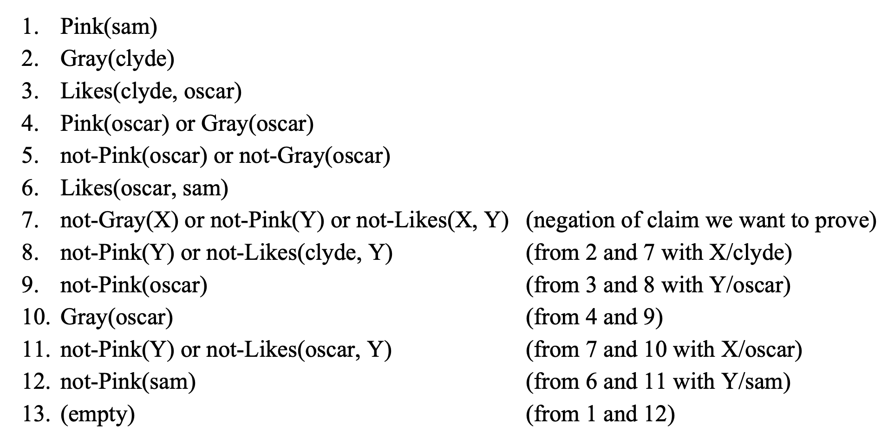
Nilsson's Elephants Resolution Reasoning

Slide 153
Finding A Satisfying Variable Assignment
For propositional logic formulas given in CNF, DPLL algorithm produces a assignment for propositional values that satisfies those formulas
For general predicate logic, resolution until empty clause pops up only establishes satisfiability, but does not give variable assignment
Easy modification does the trick: instead of adding the negation not-ɸ of the formula ɸ that we wish to prove, add the formula (not-ɸ ∨ Ans(x)) instead, where Ans is a new predicate whose parameters are the interesting variables
Instead of resolving until empty clause, resolve until Ans becomes singleton
Read the satisfying assignment of interesting variables there

Slide 154
Set of Support
During resolution reasoning, there are usually far too many possible resolution steps that could legally be taken at any given time
In systematic search, such branching makes searching exponentially long
Set of support: Some of the clauses are marked special "supporting" clauses, initially only the negated conclusion is marked as such
In each resolution step, at least one of the clauses must be supporting
Resulting clause from resolution step is added to the set of support
If the empty clause can theoretically be reached using unlimited resolution, it can also be reached under this restriction with less branching

Slide 155
Unit and Input Resolution
Unit Resolution: in each resolution step, at least one of the two resolved clauses must be a unit clause
Input Resolution: in each resolution step, at least one of the two resolved clauses must be a from the initial set of original clauses
Neither strategy is refutation complete for arbitrary sets of initial clauses, but both are complete for sets of Horn clauses
For a more general set of initial clauses, an empty clause can be reached with unit resolution if and only if it can be reached with input resolution

Slide 156
Linear Resolution
Linear resolution is an important relaxation of input resolution discipline
In each resolution step, at least one of the clauses is one of the initial clauses, or an ancestor of the other clause in the proof tree
Produces proof trees whose shape is linear
Refutation complete for all sets of disjunctive clauses
Can be optimized further by using the negation of goal as the top clause, and still remains refutation complete
Remains refutation complete under further restriction that ancestor clauses are limited to merges, literal collapses to singleton under unification

Slide 157
Situation Calculus
Technique to model dynamic world using first order predicate logic
Fluents are predicates whose truth value depends on current situation in addition to their actual parameters, situations reified as objects in models
Laws of environment expressed as non-logical axioms of form (Pre(s) ⋀ Result(s, a, s')) ⇒ Post(s')
Pre(s) expresses the precondition that action a is possible in situation s
Result(s, a, s') says that performing action a in the situation s can create the new situation s' (this predicate is not necessarily deterministic)
Post(s') describes the new situation s' resulting from action

Slide 158
Frame Problem
In sense of the fixed background of an animation frame, we need to way to somehow describe all the things that performing the action does not change
That is, every Foo for which Foo(s) ⇔ Foo(s')
Cannot be expressed directly in first order logic, since we can't quantify over predicates to say "For all predicates other than these..."
If this problem isn't solved somehow, we can't infer anything about s'
See the famous "Yale shooting problem" for a toy example that is surprisingly difficult to solve using first order logic and situation calculus

Slide 159
More Difficulties With Situation Calculus
In a complex interconnected environment, situation calculus is difficult
Qualification problem: formula Pre(s) becomes horrendously complex
In shooting problem, bullet must not be made of bubblegum, etc.
Ramification problem: formula Post(s') becomes horrendously complex
In addition to their direct consequences, actions can have many indirect consequences to their environment
Moving a box from point A to point B also moves everything inside the box and on top of it, including all the dust
Nondeterminism: predicate Result(s, a, s') is not a function

Slide 160
Higher-Order Predicate Logics
Propositional logic is a special case of predicate logic that has no literals or function symbols, and all predicates are nullary
Propositional logic can be thought of as zeroth-order predicate logic
Seems obvious to now ask if there exist second order and higher logics
Second order logic allows quantifiers over first order predicates
For example, can say ∀ P: ∃ x: P(x) to say that for every unary predicate, there must be one object that makes that predicate true
Second order logic does not allow computable proof theory

Slide 161
Module 9: Bayesian Probabilities

Slide 162
Kolmogorov Axioms
Even though probabilities are subjective and reasonable Bayesians can disagree based on their different observations and evidence, any coherent assignment of probabilities must still satisfy the Kolmogorov Axioms:
Every P(A) must be a real number in range [0, 1]
For any A and B, must have P(A ∨ B) = P(A) + P(B) – P(A ∧ B)
Several other truths of probabilities follow from these two axioms, such as:
P(True) = 1, P(False) = 0, P(not-A) = 1 – P(A)
P(A ∧ B) ≤ P(A) ≤ P(A ∨ B) (denying this is called Conjunction fallacy)

Slide 163
Easy To Be Wise After The Event
Given the same evidence, two honest Bayesians can't "agree to disagree"
With different evidence, Alice and Bob can have different views on the probability P(X) of some event X
Suppose Alice believes that P(X) = 0.2, whereas Bob believes P(X) = 0.7
Alice can offer Bob a bet where she bets not-X, offering odds up to 3 to 7
Expected value for Bob is 0.7 * $3 – 0.3 * $7 = $0, he should accept
However, even if Bob's assessment is more realistic, Alice can still get lucky
Even if X turns out to be false, it doesn't follow that Carol who claimed that P(X) = 0 would have been the most correct of the trio

Slide 164
Use of Probabilities
Recall that our problem is to make an agent choose the optimal action
Action values depend deterministically on hidden variables of environment
For example, values of "call" and "fold" on Texas Hold'Em table depend on opponent's pocket cards (hidden) and the board (observed)
Sometimes logical reasoning can reveal values of hidden variables
In presence of uncertainty, hidden variables are given probabilities
Compute the expected value of the action by averaging action value over all hidden variable combinations, weighted by probabilities
Choose the action with the highest expected value

Slide 165
Choosing Action With Highest Expected Value
At the Texas Hold'em table, river card brings a third heart on the table
Opponent chortles and bets $100 into a $100 pot, representing made flush
Suppose we flopped the middle two pair and didn't improve
Values of actions "call" and "fold" depend on the opponent's hole cards
These hole cards are hidden variables that determine the exact action values
Our best estimates of the opponent's hole card probabilities determine the expected values of our possible actions "call" and "fold"

Slide 166
Range, Equity, Maximize
Range: estimate the probabilities of hidden variables based on the observed actions during the hand, here based on opponent modelling
Let's say we assign probabilities to opponent's hole cards:
Bluffing with air 30%; semi-bluffing with weaker hand, 20%; made flush, 50%
Equity: calculate the expected value of each action over all possible combinations of hidden variable values, weighted by probabilities
EV(Call) = (30% + 20%) * $200 + (50% * –$100) = $50
EV(Fold) = $0
Maximize: choose the action "Call"

Slide 167
Denying Kolmogorov Axioms
Suppose Joe Palooka believes P(A) = 0.4 and P(B) = 0.3, but P(A ∨ B) = 0.8
Kolmogorov axioms would now entail P(A ⋀ B) = –0.1, impossible
However, as a free man and a singular individualist, Joe doesn't feel the need to follow some axiom system just because it's internally consistent
The cosmic "must" that forces everybody to follow these axioms comes from the expectation of "putting your money where your mouth is"
Talk is cheap, and anyone can flap their gums as they wish
For probability assignment that violates these axioms, it is always possible to create a Dutch book of bets that is guaranteed to lose

Slide 168
Dutch Book Example of Incoherent Beliefs
We will offer the following bets to Joe in sequence:
Each bet has positive expected value to Joe, so he should accept
If not, we can ask Joe why not
Proposition | Joe's belief | Our side of the bet | Joe's stake to ours
A | 0.4 | A | 6 to 4 + ε
B | 0.3 | B | 7 to 3 + ε
A ∨ B | 0.8 | not-(A ∨ B) | 8 to 2 + ε

Slide 169
Dutch Book Is A Guaranteed Loss
Trap is sprung! We can now even let Joe choose truth values of A and B
Joe is guaranteed to lose, ergo his beliefs can't be coherent
Our bet | A ∧ B | A ∧ not-B | not-A ∧ B | not-A ∧ not-B
A | –6 | –6 | 4 | 4
B | –7 | 3 | –7 | 3
not-(A ∨ B) | 2 | 2 | 2 | –8
Net for joe | –11 | –1 | –1 | –1

Slide 170
Subjectivist vs. Objectivist Probabilities
Objectivist view sees probabilities as real properties of physical things
Frequentism defines P(A) as the limit of proportion that A is observed over repeated similar experiments
Reference class problem of what counts as "similar" for this purpose
Cannot assign probabilities to one-time events and unique events ("What is the probability that P = NP? Or probability that Goldbach conjecture is true?")
Subjectivist probabilities model the degree of belief of the agent
How to confuse a Bayesian: Ask him where he gets his priors

Slide 171
Unknown Weighted Coin
You are given a coin that is known to be somehow weighted and not fair
No information provided which way the coin is weighted, and how much
Question: What is the probability that the next coin flip gives heads?
Bayesian: We have no reason to assume either side more probable, so 1/2
Frequentist: We don't know, except that we know that it can't be 1/2
From same premises, both philosophies reach the exact opposite conclusion

Slide 172
The Known and The Unknown
Famous three-way classification by U.S. SecDef Donald Rumsfeld
Known knowns: Deterministic known rules (chess, checkers)
Known unknowns: Nondeterminism that is constrained to follow a known probability distribution (roll of dice, draw of cards)
Unknown unknowns: Opponent's resources or the rules themselves are uncertain (sitting down at the poker table, some player suddenly plays the Uno reverse card, reversing the direction of the betting action on that round)
Second-order probabilities ("What is the probability that the coin is fair?")
To complete the 2-by-2, what would Unknown knowns be?

Slide 173
Over-Under Estimation
Classic riddle: How many piano tuners are there in Chicago?
Your over-under of an unknown numerical quantity is a value x that makes you indifferent between the bets "True value < x" and "True value > x"
Gifted one side of the bet, you would not pay anything to switch sides
Can be used to estimate subjective probabilities by adjusting stakes
Before you assert that P(A) = p, consider the bet "If A, win (1 – p)$M, otherwise lose p$M", where $M is some amount of real money whose loss would not be painful but not catastrophic to you
Adjust p until you are indifferent between both sides of bet

Slide 174
Why We Are Doing All This
Recall that we are trying to make the agent choose good actions
If the environment isn't fully observable, some variables are hidden
These variables affect the expected values of actions
For example, in heads-up poker, hidden variables are opponent's cards and mindset, evidence variables are our cards, board, and betting action
Values of agent's possible actions such as "call", "raise" and "fold" depend greatly on these hidden variables
Diagnostic reasoning from evidence variables to hidden variables

Slide 175
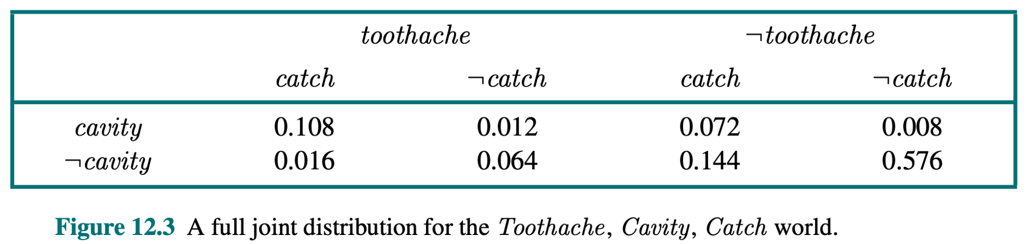
Full Joint Distribution
For n propositions, 2^{n} entries adding up to one
Can be used to tally up any probability query

Slide 176
Estimating Probabilities From Sample Data
Assume m independent snapshots of the world that we wish to model
We have n propositions that correspond to some facts of the world
Build the full joint distribution of 2^{n} possible combinations of probabilities
Estimate P(ɸ) with the formula N(ɸ) / m
N(ɸ) is the number of worlds where ɸ is true
Unbiased estimate for P(ɸ)
Full joint distribution table doesn't give us the underlying causality: you may end up with same full joint when A causes B, and when B causes A

Slide 177
Conditional Probabilities
Prior probabilities aren't usually enough for action selection
We need probabilities of variables, given some observed evidence
Observed evidence E rules out all possible worlds that have not-E
Formula for conditional probability is simple: P(A | E) = P(A ∧ E) / P(E)
Alternative formulation P(A ∧ E) = P(A | E) P(E) = P(E | A) P(A) = P(E ∧ A)

Slide 178
Entailed Conditional Probabilities
Mutually exclusive and fully exhaustive probabilities always add up to 1
If you know P(A | B), you also know P(not-A | B) = 1 – P(A | B)
However, even if you know P(A | B), you still don't directly know P(A | not-B)
Probabilities P(A | B) and P(A | not-B) are not related in any way
Of course, P(A) = P(A | B) P(B) + P(A | not-B) P(not-B)
Once the prior probabilities P(A) and P(B) are known, knowing P(A | B) allows us to compute P(A | not-B), and vice versa

Slide 179
Attraction and Repellence
Evidence E is said to attract the event A if P(A | E) > P(A)
Evidence E is said repel the event A if P(A | E) < P(A)
E attracts A if and only if E repels not-A
Attraction is symmetric: A attracts E if and only if E attracts A
A neither attracts E nor E attracts A if and only if A and E are independent
A and E are mutually attractive if and only if P(A | E) > P(A | not-E)

Slide 180
Combining Multiple Pieces of Evidence
Even if both evidences E and F separately attract A so that both P(A | E) > P(A) and P(A | F) > P(A), it doesn't necessarily follow that P(A | E ∧ F) > P(A)
Even if F attracts E and E attracts A so that P(E | F) > P(E) and P(A | E) > P(A), it doesn't necessarily follow that P(F | A) > P(F)
Can you think up real world interpretations for A, E and F to illustrate these counterintuitive claims about conditional probabilities?

Slide 181
Marginalization
We sometimes have some prior probability P(A) that we wish to compute
Such a prior probability might appear as a part of some other calculation
Marginalization rule: P(A) = P(A ∧ B) + P(A ∧ not-B)
B can be literally any formula whatsoever, so we always choose it tactically
P(A ∧ B) can then be rewritten as P(B) P(A | B) with chain rule
If P(B) is not known, solve it the same way using some tactically chosen C
P(B) = P(B ∧ C) + P(B ∧ not-C)
And so on...

Slide 182
Causal and Statistical Independence
Events A and B are independent if P(A) = P(A | B) and P(B) = P(B | A)
Alternative formulation for independence is P(A ∧ B) = P(A) P(B)
Even if A and B have no causal connection in the laws of nature of the underlying world, A and B are not necessarily statistically independent
There could be some underlying hidden cause C that causes both A and B
By diagnostic reasoning, P(A) ≠ P(A | C), therefore P(B | A) ≠ P(B)

Slide 183
Causality Despite Independence
Even if A and B are causally connected, can still be P(A ∧ B) = P(A) P(B)
Statistical independence does not rule out causal relationship per se
Consider three bits A, B and C, so that A and B are mutually independent random coin flips, whereas C is given by the exclusive or of A and B
P(C) = P(C | A) and P(C) = P(C | B)
C is independent of both A and B separately, despite being caused by them
However, C is not independent of A ∧ B, since P(C | A ∧ B) = 0
(Exercise for the reader: is C independent of A ∨ B ?)

Slide 184
Two Classic Bad Jokes From A Simpler Time
Whenever evidence E is available, P(A) is meaningless next to P(A | E)
In a bad old joke from a very different era, a guy was afraid to fly because there could be a bomb in the plane with small probability P(B)
To allay his fears, he took his own bomb with him to the plane, reasoning that the squared probability P(B)² of two bombs on the plane is practically zero
In another bad joke from the same era, an old man was close to death
To extend his life, he intentionally got infected with HIV, since he had read that with modern medicine, an average HIV patient lives over a decade
Without hand waving, what was the mistake in each case?

Slide 185
Causal And Diagnostic Reasoning
Causal connections between propositions A and B may be known from the known laws of nature of the world from which A and B comes from
For example, fire causes smoke, but smoke doesn't cause fire
If B is observable, causal reasoning uses conditional probability P(A | B)
If A is observable, diagnostic reasoning via Bayes Theorem P(B | A) = P(A | B) P(B) / P(A)
"Google uses Bayes theorem like Microsoft uses if-else"

Slide 186
Athens Taxicab Hit-and-Run
Along with Monty Hall, kind of Hello World of Bayesian reasoning examples
Being inebriated, you walk home after night of drinking
Witness a hit-and-run involving a taxicab
Athens taxicabs are either green or blue
To you, the taxicab appeared to be blue, but it was dark
Let B mean "taxicab was blue", and A mean "taxicab appeared blue"
Low prior P(B) = 0.1
P(A | B) = 0.75, P(A | not-B) = 0.25
What is P(B | A) ?

Slide 187
Bayes Rule to the Rescue
Always solve this kind of problems without intuition or hand waving
Just plug numbers into equations and see what comes out
P(B | A) = P(A | B) P(B) / P(A) = 0.75 * 0.1 / P(A) = 0.075 / P(A)
P(not-B | A) = P(A | not-B) P(not-B) / P(A) = 0.25 * 0.9 / P(A) = 0.225 / P(A)
Use marginalization to solve P(A):
P(A) = P(A | B) P(B) + P(A | not-B) P(not-B) = 0.075 + 0.225
For final answer, P(B | A) = 0.075 / (0.075 + 0.225) = 1/4

Slide 188
Solving Conditional Probabilities with Frequencies
In some factory, 85% of produced items are good and 15% are defective.
A good item is mistakenly rejected with probability 0.1, whereas a defective item is correctly rejected with probability 0.95
What is the probability that an item from the store is defective?
Let D mean "item is defective" and I mean "item passed inspection"
P(D | I) = P(I | D) P(D) / P(I), solved same way as previous
In one-step diagnostic reasoning, can also use frequencies to solve, to examine the distribution of Bayesian waterfall
More intuitive than probabilities

Slide 189
Solution with Frequencies
Consider a batch of 10,000 items produced by the factory
Of these, 8,500 are good and 1,500 are defective
Of 8,500 good items, 850 were mistakenly rejected and 7,650 reached the store
Of 1,500 defective items, 1,425 were correctly rejected and 75 reached the store
Therefore from this batch, 7,650 good items and 75 bad items reach the store
A consumer who buys a random item gets a defective item with probability 75 / (75 + 7650) = 0.0097

Slide 190
Base Rate Fallacy
Bayes rule says that P(A | B) = P(B | A) P(B) / P(A)
Common fallacy to assume that P(A | B) = P(B | A)
Effectively asserting that base rate P(B) / P(A) = 1
Base rate describes how common events A and B are relative to each other
Base rate can be anything from 0 to infinity, depending on A and B
Often a good way to lie with statistics, when trying to convince innumerate readers, and score all kinds of cheap rhetorical points
Also known as "Prosecutor's Fallacy" or "Defender's Fallacy", depending on which way the rhetoric is supposed to sway the audience

Slide 191
Extraordinary Evidence
If P(A) is in (0, 1), new evidence can always theoretically swing it arbitrarily so that P(A | E) can be any value in [0, 1], no matter what P(A) was before E
If this is the case, what use is knowing that, say, P(A) = 0.01, if some evidence E could theoretically arrive that makes P(A | E) = 0.99?
How can we know that we have collected enough evidence to act?
Probability P(E) of such extraordinary evidence must itself be small
Extraordinary changes of probability estimates can only be caused by evidence that is extraordinary unlikely to appear

Slide 192
Cromwell's Rule
If P(A) = 0, then P(A | E) = 0, and if P(A) = 1, then P(A | E) = 1
Once some probability has been determined to be 0 or 1, no additional evidence can change that, even if Good Lord himself told us otherwise
When solving real problems that someone would actually pay us to solve, this is a pretty heavy position to make in our fallible knowledge
Other people and sources of info can always be lying or honestly mistaken
If you really believe that P(A) = 0, are you ready to accept the bet where your head is chopped of in a guillotine if A turns out to be true?
Treat probabilities 0 and 1 as if they were ε and 1 – ε

Slide 193
Full Joint Distribution, Again
For n propositions, 2^{n} entries adding up to one
Can't simplify further than 2^{n} – 1 entries

Slide 194
Conditional Independence
The full joint distribution has 2^{n} entries to encode the ways that the n propositions depend on each other
Propositions can depend on each other either directly or indirectly
For example, suppose some C has an effect on both A and B
Despite the fact that A and B have no causal dependency of each other, they are not statistically independent of each other, but P(A | B) ≠ P(A)
However, once the hidden common cause C has been given, A and B become conditionally independent of each other, P(A | C) = P(A | B ∧ C)

Slide 195
Simplifying the Full Joint
If conditional independence is known (or assumed), some entries of the full joint distribution become redundant
The table no longer needs to contain 2^{n} entries, but can be encoded into a directed acyclic graph called a Bayes network or belief network
One node per proposition, each node has some nodes as parents
If node has k parents, its probability table has only 2^{k} entries
For node X, probabilities can be fully given as P(X | Parents(X)), with the remaining nodes ignored as redundant at this point

Slide 196
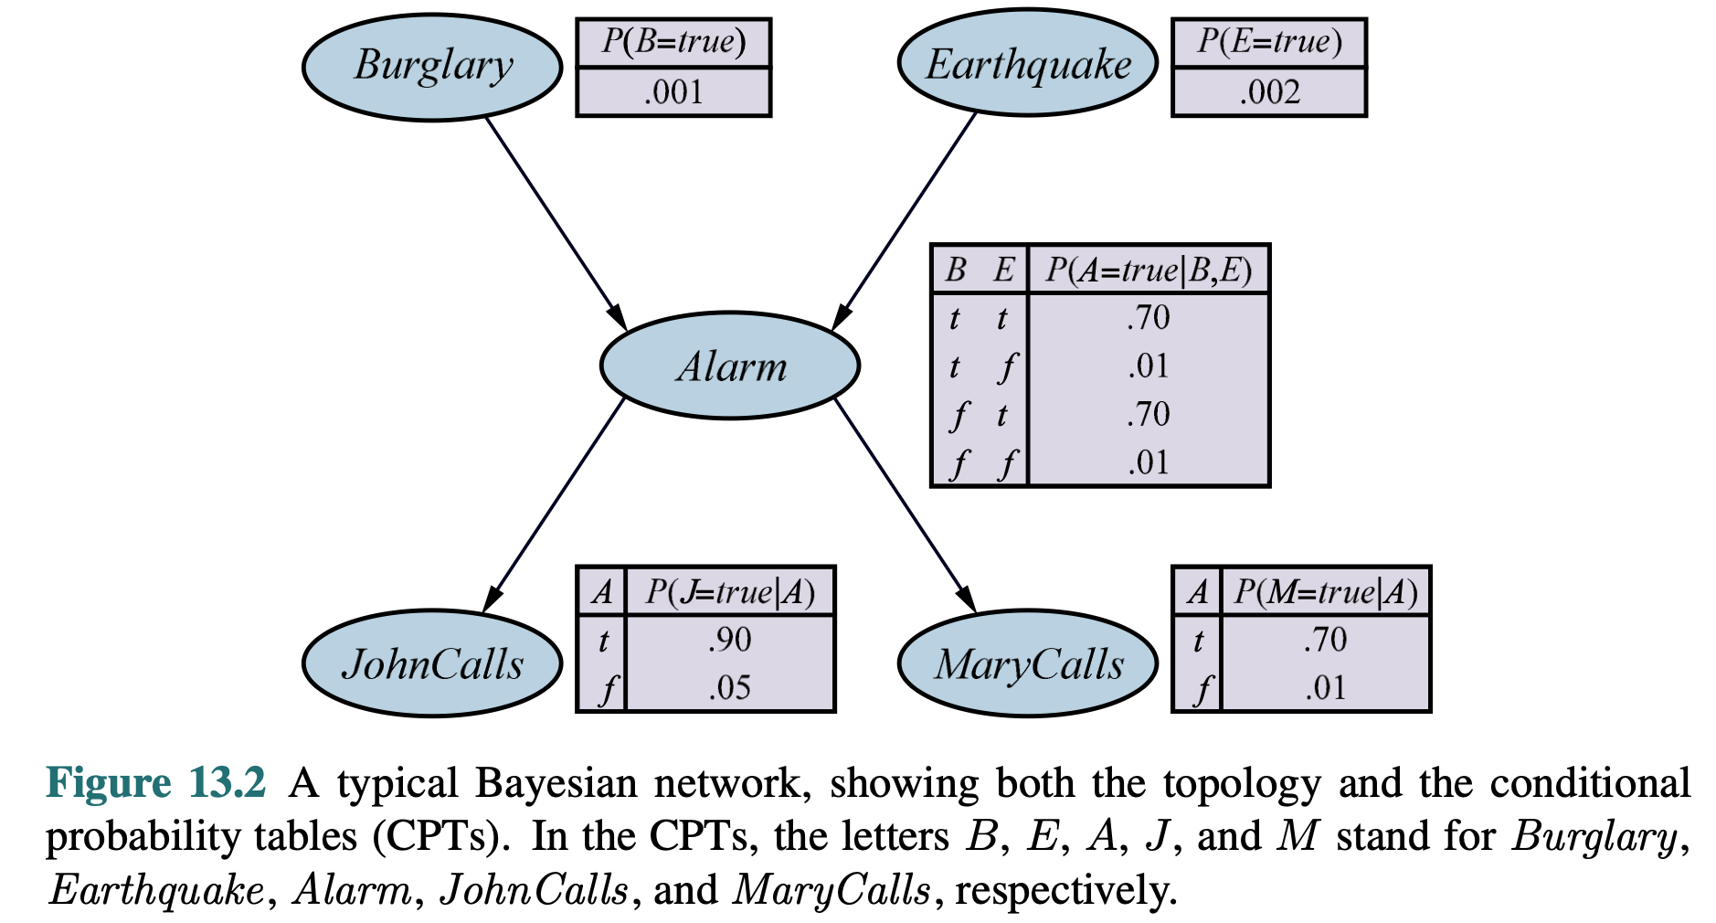
Example Bayes Network

Slide 197
Building a Bayes Network
Consider model of world with n propositional variables
In principle, could build network for any of the n! possible variable orderings
In practice, sort variables in order of causality
This tends to keep number of parents smaller for each node, and also make conditional probability values easier to estimate
To add a new variable X, find a good subset S of all previous nodes E so that P(X | E) = P(X | S), making X is conditionally independent of E – S given S
Important machine learning problem to derive a good Bayes network from the given set of training samples

Slide 198
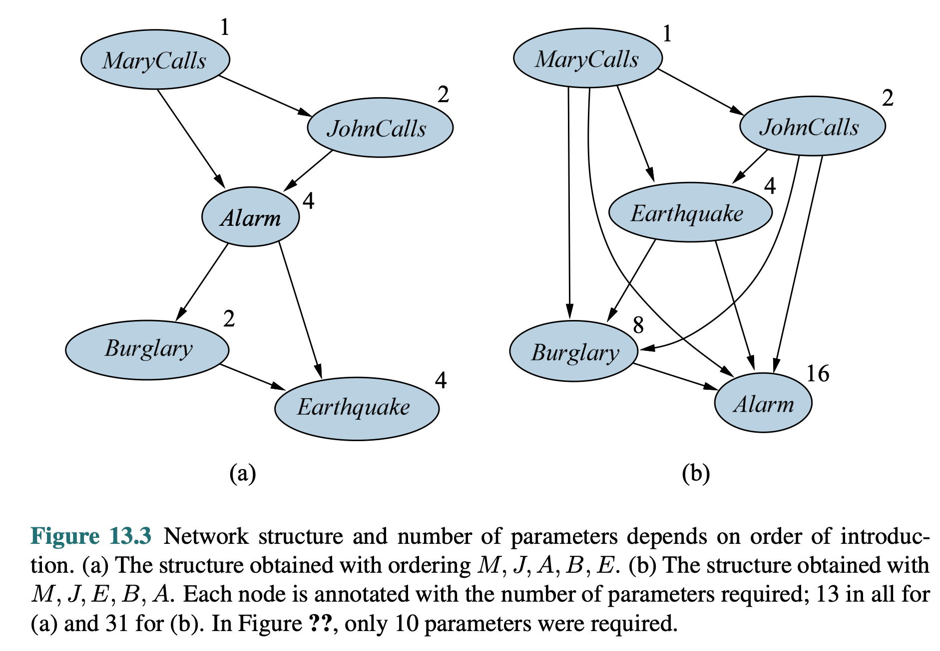
Variable Ordering Can Have a Big Effect

Slide 199
Bayes Network Encodes Entire Full Joint
Bayes network implicitly contains all information of the full joint distribution, and can in principle be used to compute P(ɸ) for any formula ɸ
To compute the probability for each individual possible world, initialize probability counter to one, and loop through nodes in topological order
For each node X, multiply probability by P(X | Parents(X))
Evaluating P(ɸ) can require an exponential number of operations
Exact calculation of P(ɸ) is NP-complete, only exponential algorithms known

Slide 200
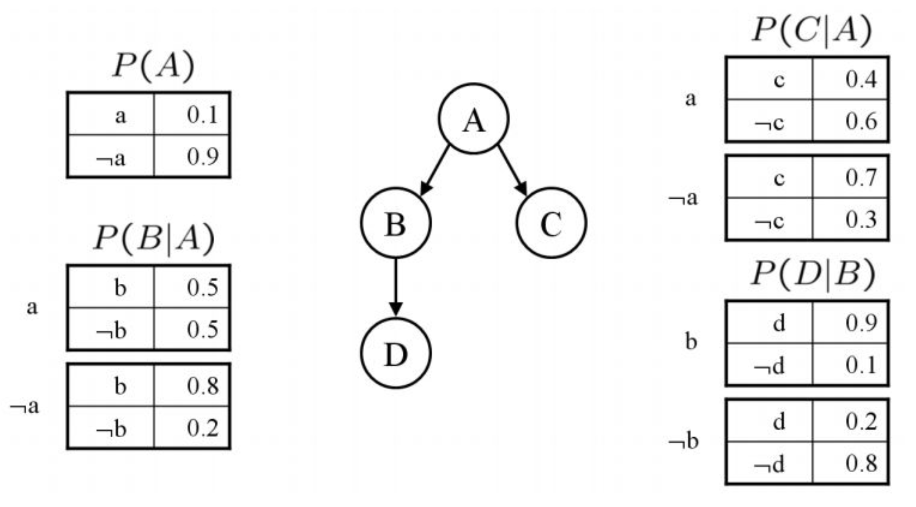
Exact Evaluation in Bayes Network

Slide 201
Rules for Exact Evaluation
Each node of a Bayes network is conditionally independent of its non-descendants, given all its immediate parents
Parents shield the node from its earlier ancestors in the calculation
Each node of a Bayes network is conditionally independent of all other nodes, given its Markov blanket of its parents, children and children's other parents
These other parents determine the way that known values of the child nodes affect the probability of the node in question
Bayesian networks on graphs A→B→C and C→B→A are equivalent in that impose the same conditional independence requirements

Slide 202
Exact Evaluation in Bayes Network: Example 1
P(B ∧ C | A)
= P(B | A) P(C | B ∧ A) (chain rule for B ∧ C )
= P(B | A) P(C | A) (​C is conditionally independent of B, given A)​
= 0.5 * 0.4 = 0.2

Slide 203
Exact Evaluation in Bayes Network: Example 2
P(D | A)
= P(D ∧ B | A) + P(D ∧ not-B | A) (​marginalization on B​)
= P(B | A) P(D | A ∧ B) + P(not-B | A) P(D | A ∧ not-B)
= P(B | A) P(D | B) + P(not-B | A) P(D | not-B)
(​D is conditionally independent of A, given B)​
= 0.5 * 0.9 + 0.5 * 0.2 = 0.55

Slide 204
Exact Evaluation in Bayes Network: Example 3
P(A | D) = P(D | A) P(A) / P(D) (​straight up Bayes when going up​)
= ( P(D ∧ B | A) + P(D ∧ not-B | A) P(A) / P(D) (​marginalization on B​)
= ( P(B | A) P(D | B) + P(not-B | A) P(D | not-B) ) P(A) / P(D)
= 0.055 / P(D)
P ( not-A | D ) = ... = 0.684 / P (D) ( same way as P(A | D) )​
P(A | D) = 0.055 / (0.055 + 0.684) = 0.074 (since P(A | D) + P(not-A | D) = 1)

Slide 205
Constructing Any Individual Entry in Full Joint
Once you have constructed a Bayes network, can quickly compute the exact value of any individual entry of full joint distribution
Start with initial probability 1
Loop through nodes in some topological sorted order
For each node X, multiply current probability with P(X | Parents(X))
Resulting probability of the product is the exact entry in the full joint for that assignment of values for n propositions

Slide 206
Generating a Random World
Similarly easy to generate a random world from the probability distribution
Loop through nodes, make each X true with probability P(X | Parents(X))
Resulting world is generated with exact probability of its full joint entry
What about is some variables have been given as evidence?
Rejection sampling: discard all of these randomly generated worlds that are counter to the given evidence
Can be used to estimate probabilities P(H | E) for hidden variables given evidence E that are relevant to agent's action selection
Generate N sample words, count in how many H are true

Slide 207
Likelihood Weighting
If some evidence variables have low priors of occurring, rejection sampling will have to discard vast majority of random samples
A better technique for random sampling is to force the evidence variables to their given values, but update the weight of that sample
Each sample is initially of weight of 1
When evidence variable E is forced to given value, multiply the weight of that sample by P(E | Parents(E))
Each sample contributes to estimate of P(H | E) according to its weight

Slide 208
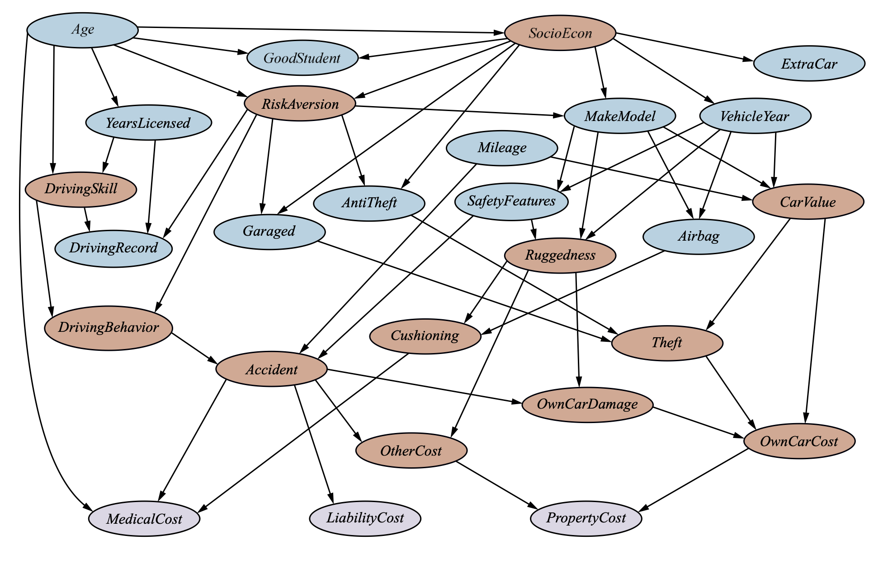
More Complex Bayes Network

Slide 209
Explaining Away
Consider unlikely symptom E so that P(E) is small
Assume two possible separate causes A and B for E
For example, E is burglar alarm, A is burglar, B is cat playing with alarm
Both P(E | A) and P(E | B) are large
Since P(E) is small, also P(A) and P(B) must be small a priori
However, P(E | A) is significantly larger than P(E)
Yet, P(E | A ∧ B) is again small, far closer to prior P(E)
Known cause B for E makes the competing cause A less likely
Important if A is serious, whereas B is harmless

Slide 210
Analyzing Causality With Do-Operator
What if we want to find out the underlying causality?
Joint distribution itself would allow either true direction causality
Can use do-operator and do-calculus devised by Judea Pearl and friends
What effect does forcing the value of some variable to a fixed value have to the probabilities of other variables in the network?
Forcing the value of A to be true is denoted by do(A = true)
Variable A no longer produces information about its ancestors
Effectively eliminates the incoming arrows from variable A

Slide 211
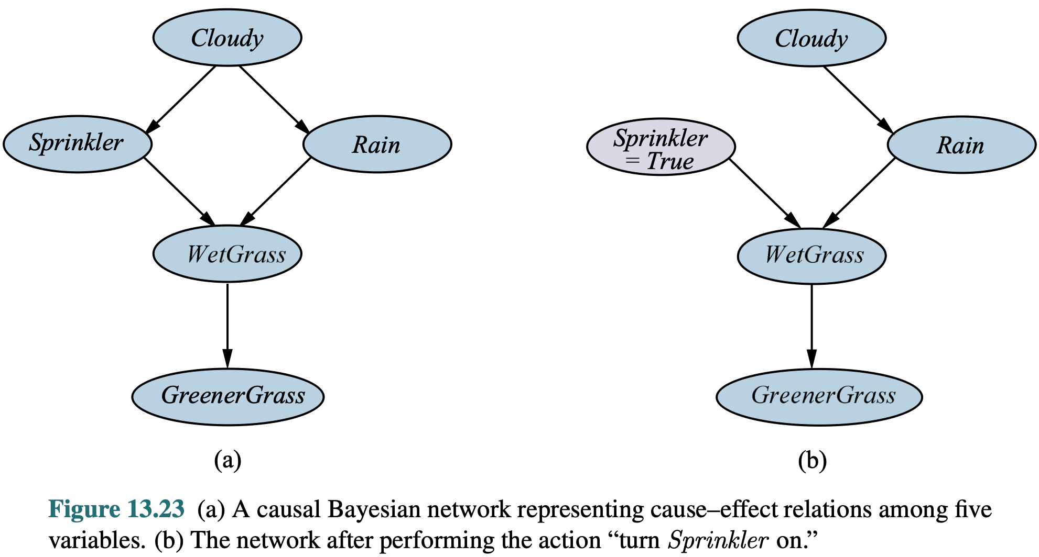
Example Of Using The Do-Operator

Slide 212
Inferring Causality
A variable that is forced to be true is effectively "caused" by our hand
Important: P(A | B) is generally not equal to P(A | do(B))
If A and B have common ancestors, do(B) does not affect the diagnostic probabilities of these ancestors, whereas B becoming "naturally" true via the influence of these ancestors provides information about these ancestors
In brief, causality is everything that makes P(A | B) and P(A | do(B)) different!
Can study and quantify effects of forced interventions
To learn more about reasoning about causality, interested students can consult the highly readable "The Book of Why" by Judea Pearl

Slide 213
Bayesian Updating Example
(From Think Bayes 2nd Ed, Allen Downey)
You have a set of dice from Dungeons and Dragons
These dice has 4, 6, 8, 12 and 20 sides, respectively
You choose one die at random and roll it
Suppose you get a six on the first roll
What is the probability for each die that it was the one that you rolled?
Obviously not the 4-sided die, but couldn't all other dice produce a six?
Yes they can, but not with the same probability
Imagine if there was also a trillion-sided die

Slide 214
Bayesian Updating Example (cont.)
Can ignore the difficult term P(E), since it's an equal constant factor for all
H | P(H) | P(E | H) | P(H | E) = P(E | H) P(H) / P(E)
d4 | 1/5 | 0 | 0.0
d6 | 1/5 | 1/6 | 0.392
d8 | 1/5 | 1/8 | 0.294
d12 | 1/5 | 1/12 | 0.196
d20 | 1/5 | 1/20 | 0.117

Slide 215
Bayesian Updating Example (cont.)
Suppose we roll several times and get results E = [6, 7, 7, 5, 4]
After the calculations, the updated conditional probabilities are
H | P(H | E) = P(E | H) P(H) / P(E)
d4 | 0.0
d6 | 0.0
d8 | 0.943
d12 | 0.055
d20 | 0.001

Slide 216
Doomsday Argument
Famous thought experiment based on Bayesian updating of priors
In a finite universe, there will be some total number of humans who will ever have existed before the universe reaches heat death; let's call this number N
What is your best over/under estimate for the value of N?
Assume that all humans are numbered 1, 2, 3, … as they are born
You are currently human number about 60 billion plus chump change
Use Bayesian updating to compare hypotheses for various values of N
Doomsday for humanity is probably relatively near!

Slide 217
Applying Hypotheses to Make Predictions
Having calculated the probabilities for these competing mutually exclusive hypotheses, how do we use these probabilities to predict the future?
For example, what is the probability that the next dice roll will show 11?
Easy way: use the Maximum Likelihood Hypothesis whose probability is currently the highest, given the evidence observed
Use the approximate prediction P(X) = P(X | H_{ML})
Can be wildly off, if several hypotheses are equally likely

Slide 218
Using All Hypotheses for Predictions
Better way: marginalize predictions weighted by hypothesis probabilities
P(X | E) = P(X | H₁∧ E) P(H₁ | E) + … + P(X | H_{n} ∧ E) P(H_{n} | E)
Since X is conditionally independent of E given H, this simplifies to:
P(X | E) = P(X | H₁) P(H₁ | E) + … + P(X | H_{n}) P(H_{n} | E)
Gibbs sampling: choose a random hypothesis H_{r} weighted by P(H_{r})
Using only this H_{r}, error probability still surprisingly small

Slide 219
When Only Unlikely Hypotheses Survive
The initial set of hypotheses must cover all possible situations that can occur
Technique works only when we are dealing with "Known unknowns"
However, sometimes the evidence E is so surprising that only hypotheses that were highly unlikely a priori survive that evidence
Even though the original prior probabilities of the surviving hypotheses were something like 10^{–10} and 10^{–20}, the posterior probability of one being 1 – 10^{–10} and the other being 10^{–10} leaves little doubt of which one to bet on
Once you have eliminated the impossible, what remains must be the truth

Slide 220


Slide 221
From Casino (1995 film)
Ace Rothstein : Four reels, sevens across on three $15,000 jackpots. Do you have any idea what the odds are?
Don Ward : Shoot, it's gotta be in the millions, maybe more.
Ace Rothstein : Three fuckin' jackpots in 20 minutes? Why didn't you pull the machines? Why didn't you call me?
Don Ward : Well, it happened so quick, 3 guys won; I didn't have a chance...
Ace Rothstein : [interrupts] You didn't see the scam? You didn't see what was going on?
Don Ward : Well, there's no way to determine that...
Ace Rothstein : Yes there is! An infallible way, they won!

Slide 222
Into Default Logic
Other forms of uncertainty are modelled with different techniques
Consider the following facts, expressed as a tiny story in spirit of the AI researcher Roger Schank (1946–2023)
(The instructor happened to read one of his translated books, most likely "​The Connoisseur's Guide to the Mind​", in the local library, and here we are now.)
“​During her lunch break from her job at the bank, Linda walked into the greasy spoon diner next door. As she sat down, the waitress brought her the menu and a cup of coffee.”​
What facts are logically entailed by this story?

Slide 223
None of These Are Entailed!
Linda sat down on a chair at one of the customer tables (as opposed to, say, on the table itself, on the floor or behind the checkout counter).
Linda’s job does not involve operating heavy machinery or giving out prescription medication.
Linda took off her hat, gloves and coat before sitting down, but she did not take off her shoes.
The table that Linda sat down at had napkins, ketchup and mustard somewhere on it. Linda did not pour any of this ketchup or mustard in her cup of coffee, nor did she eat the napkins.
The coffee was hot, and Linda drank it from the cup instead of pouring it on her food. On the other hand, mustard and ketchup, if Linda later consumed any, were poured on the food.
Linda is a human (as opposed to, for example, a service dog or a carrier pigeon) and has at most two arms, at most two legs and exactly one head.

Slide 224
Default Logic
Default logic is a non-monotonic extension of predicate logic
Inference rules extended to allow default rules that are assumed to be true unless explicitly proven false
For example, every bird is assumed to be able to fly, unless proven otherwise
If tweety is a bird, we infer that tweety can fly
If tweety is later revealed to be a penguin, must revoke earlier inference
Must keep track of not just inferred sentences, but their proofs in case some of the assumptions used in the inference chain need to be revoked

Slide 225
Issues With Default Logic
Default logic does not mesh as well with decision theory as probabilities
For example, when planning to take a car drive, is your default assumption that there will be an accident, or that there will not be an accident?
If former, the rational decision is not to take that trip
If latter, the rational decision is not to bother fastening seat belt
What if two default rules are contradictory, as in the "Nixon diamond" ?

Slide 226
Module 10: One-Shot Decisions

Slide 227
Preferences
For concrete outcomes A, B and C, some agent has preferences A ≻ B ≻ C
This ordinal ordering doesn't say anything about relative preferences
For example, consider A = $1000, B = $999, C = $0
For example, consider A = $1000, B = $1, C = $0
Or even weirder, A = "get a duck", B = "get a chicken", C = "get kick in the butt"
Preferences are not themselves rational, just coherent
Coherent preferences satisfy the axioms of orderability, transitivity, continuity, substitutability and monotonicity

Slide 228
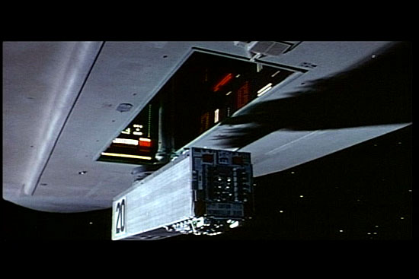
Coherent Preferences Don't Entail Own Survival

Slide 229
Lotteries
If actions have deterministic outcomes, choice of action is easy
If there is uncertainty in environment, action outcomes become lotteries
Problem: how to order different lotteries in a total order?
Even if there are only two outcomes A and B, the continuum of p in [0, 1] creates an infinite number of possible action outcomes [p, A; (1 – p), B]
For two outcomes A and B, these form a linear continuum of outcomes
Deterministic outcomes are just special cases of lotteries where one outcome has probability 1, and all others have probability 0

Slide 230
Utility Functions
If your utilities are coherent, there exists a utility function that maps every lottery into a real number, so that this utility function embeds your entire preference structure into the real number continuum line
A ≻ B if and only if U(A) > U(B)
Utility U(L) of any lottery L = [p₁, S₁; ... ; p_{n}, S_{n}] equals the weighted sum of utilities of outcomes S_{i} weighted by their probabilities p_{i}
Outcomes of actions are now modelled as real numbers, and we can compute the expected utility of an action whose outcome is a lottery
A rational agent chooses the action with highest utility

Slide 231
Properties of Utility Functions
Utility function describing the given preference structure is not unique, but any utility function can be scaled by arbitrary positive number and shifted by any number without affecting action selection
MEU action with respect to original utility function is always the same as the MEU action with respect to scaled and shifted utility function
Even when the rational agent does not consciously calculate utilities, it will choose its actions as if were doing such calculations
Rational agent can be implemented as a reflex agent with a lookup table

Slide 232
Turning Ordinal Preferences Into Cardinal
To measure the relative cardinalities of A ≻ B ≻ C, let's use over-under
Find the probability p so that [p, A; (1 – p), C] ～ B
This probability measures where B ranks between A and C
Low value for p indicates that utility of B is close to utility of C
High value for p indicates that utility of B is close to utility of A
The bigger risk of getting the worst outcome C you are willing to take to get a shot for the best outcome A, the more you value that best outcome

Slide 233
Utility of Money Is Not Linear
For being such a good student, the friendly billionaire Tony Stark enters the lecture room to offer you a reward, the choice of two lotteries: A: [0.8, $4000; 0.2, $0] B: [1.0, $3000]
Noting that EV(A) = $3200 and EV(B) = $3000, which one will you choose?
What if this same lottery were offered to you a hundred times in a row?
What if B was [1.0, $2000] instead?

Slide 234
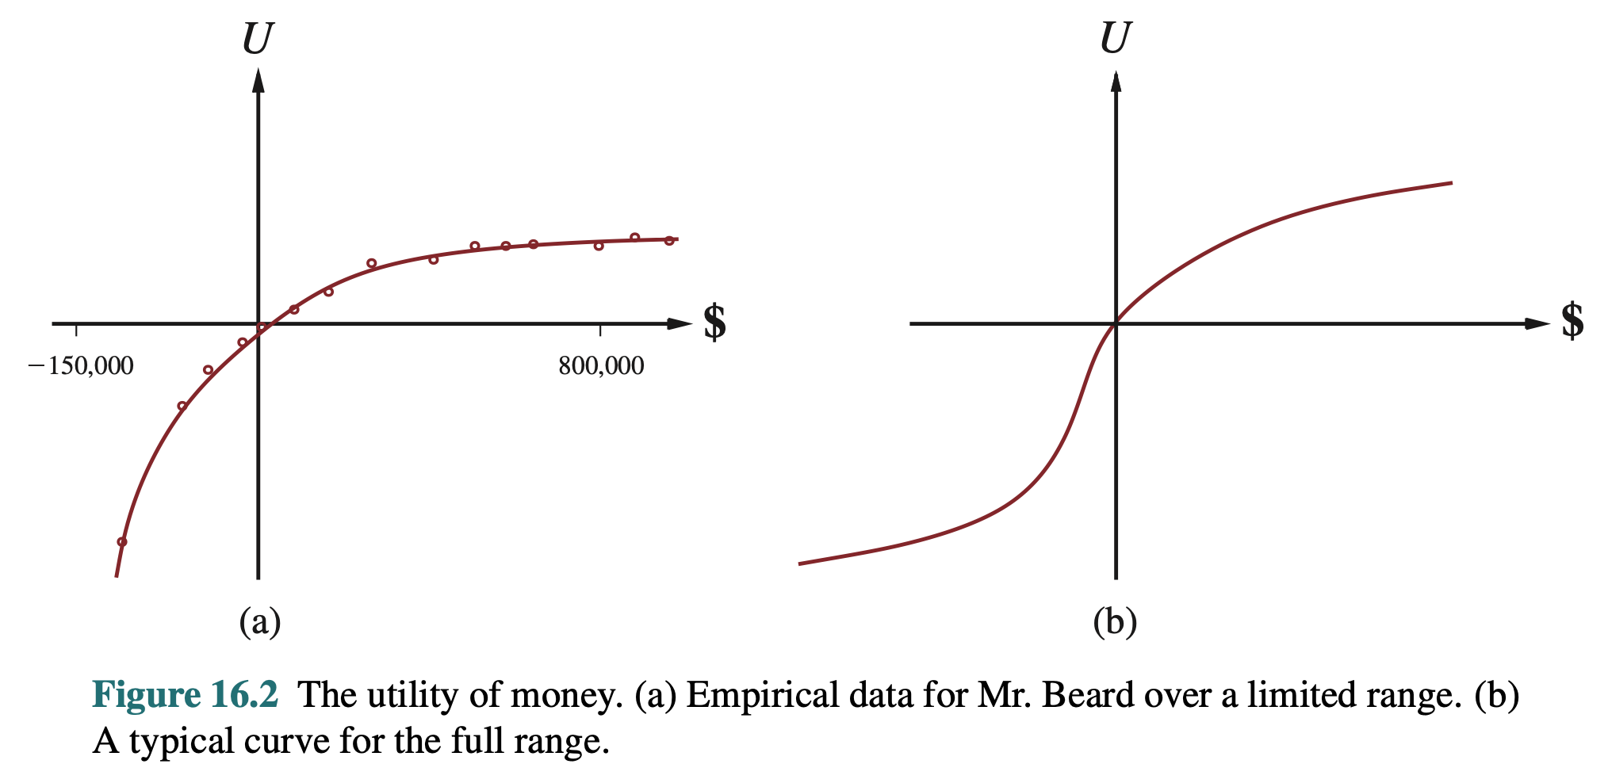
Convex Utility of Money
Utility of money is not linear, but usually follows a convex logistic curve
Even though EV(A) > EV(B), we still have EU(A) < EU(B)

Slide 235
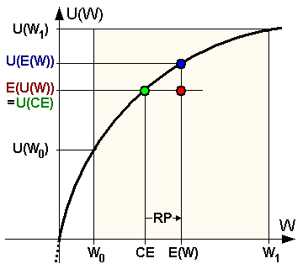
Convex Utility Curves Cause Risk Aversion
Line segment connecting any two points U(W₀) and U(W₁) on a convex utility curve lies fully below that curve
Rational agents become risk-averse
Consider lottery W = [p, W₀; (1 – p), W₁]
U(EV(W)) > E(U(W))
This equation holds for any 0 < p < 1

Slide 236
Utility In The Large and In The Small
All utility curves are effectively linear on a small enough scale, and maximizing expected utility coincides with maximizing expected value
When playing poker for pennies, maximizing value is maximizing utility
When playing poker for too high stakes, rationally maximizing utility becomes trying to avoid loss, so the player makes suboptimal actions
See the colourful tale of billionaire banker Andrew Beal against top Vegas poker players told in The Professor, The Banker and The Suicide King

Slide 237
Principle of Maximum Misery
Most material on convex utility of money looks at only the positive side
This coin has a flip side on the negative side of losses
On the negative side of losses, the utility function is concave, so rational agents suddenly become risk-seeking
Once the losses are large enough, larger losses become meaningless
Agent starts chasing losses with desperate bets
Once you have lost all your life savings, a double-or-nothing bet with 40% chance to win and 60% chance to lose starts looking temptingly rational

Slide 238
Insurance Premium as Value of Certainty
Assume that for Joe, U($2500) equals U([0.8, $4000; 0.2, $0])
$2500 is called Joe's certainty equivalent for lottery [0.8, $4000; 0.2, $0]
This difference $3200 – $2500 = $700 is Joe's insurance premium
Given the lottery [0.8, $4000; 0.2, $0], Joe would be willing to trade this uncertainty for the guaranteed certainty of lump sum of at least $2500
For insurance company, money on this scale has essentially linear utility
Trade has positive EV for insurance company but EV of –$700 for Joe
Yet trade is positive EU for both sides, so it can happen
Especially important for lotteries [1 – ε, status quo; ε, disaster]

Slide 239
Allais Paradox
Recall the previous lotteries A: [0.8, $4000; 0.2, $0] and B: [1.0, $3000]
Most people choose lottery A
Consider lotteries C: [0.2, $4000, 0.8, $0] and D: [0.25, $3000, 0.75, $0]
No certain money available, most likely outcome is getting nothing
EV(C) = $800, EV(D) = $750
Most people choose C over D
However, what happens if we compare these decisions using utility theory?

Slide 240
Contradiction in Allais Paradox
B ≻ A, so 0.8U($4000) + 0.2U($0) < U($3000)
C ≻ D, so 0.2U($4000) + 0.8U($0) > 0.25U($3000) + 0.75U($0)
Two inequalities with three unknowns, not enough information
Since utility functions can be shifted without affect the rational action, let us fix U($0) = 0 (important to note that U($0) = 0 isn't the case in general)
Simplifying previous equations this way, we get 0.8U($4000) < U($3000) 0.2U($4000) > 0.25U($3000)
Multiply both sides in second inequality by 4 for contradiction!

Slide 241
Additional Factors of Rationality
When choosing an uncertain action, resulting loss has an additional sting compared to certainty that was available as an option in the beginning
This especially when other people are watching us from the peanut gallery
Anchoring to baseline: a gambler who first wins $1000 and then loses it will end up feeling worse than a gambler who first loses $1000 and then wins it back, despite the fact that both gamblers started and ended exact same
Human tendency to add up the gains of alternative actions to compare with actual outcome, despite these actions being mutually exclusive

Slide 242
Multiagent Decisions
Example: three friends together rent a three-bedroom apartment, and all three value the three available bedrooms in the preference order A ≻ B ≻ C
How to determine fairly which friend gets which bedroom?
Since we can't pop open their heads to measure their hedonic preferences, must convert their preferences into something that can be measured
Simple solution: Auction of the bedrooms as share of rent
Use price signals to measure preferences under scarcity (Economics 101)

Slide 243
Multiagent Decisions Using Indifference Principle
Another solution is based on the observation that the bedroom A gives most utility for the friend who is willing to risk the most to get it
Have each friend choose probability p that would make them indifferent between [p, A: 1 – p, C] and B
Starting from friend with lowest p, flip a p-weighted coin
That friend gets either the bedroom A or bedroom C based on that coin
The other two friends divide the other two rooms the same way
This protocol does not enforce honesty: one friend can gain by overstating their value of p that they would settle for

Slide 244
Vickrey Auction
In an ordinary sealed-bid auction, an agent with additional knowledge about the true value of an underappreciated item may gain by lowballing its bid
Simple mechanism design solution of Vickrey Auction: the highest bid wins, but the winner has to pay only the second highest bid!
Assume agent truly values the item at $P, but bids $B so that B < P
Let the highest of other bids equal $W: three possible cases
If B < P < W, the bid made no difference anyway
If B < W < P, agent missed opportunity to pay $W for value of $P
If W < B < P, bidding $B is same as bidding $P, no difference

Slide 245
Games With Simultaneous Moves
Multiagent systems make analysis of optimal action difficult
Previous lecture on game playing assumed alternating moves
When two players have to make their moves simultaneously, game is no longer a tree, but a payoff matrix
Rows are moves of first player, columns are moves of second player
Entries of payoff matrix give the outcomes for both players
In zero-sum game sufficient to give outcome for row player
If the game consists of multiple moves, evaluate subgames recursively

Slide 246
Nash Equilibrium
Famous theorem by John Forbes Nash of "Beautiful Mind" fame
For a large family of games, each player has a Nash equilibrium strategy so that no other player can gain by deviating from their strategy
For complete information games of alternating moves, Nash equilibrium strategy collapses into the principal variation
For games that are not complete information, optimal strategy is usually mixed so that in the same situation, a different move is taken each time
The Nash equilibrium strategy is optimal in the expected utility sense, since any player can still get unlucky

Slide 247
More on Nash Equilibrium
Players can even honestly announce beforehand that they follow their own equilibrium strategy, such knowledge doesn't gain anything to other players
Games with effectively simultaneous one-shot moves require mixed strategies to prevent the opponent from adjusting their strategy
Sequential games require occasional bluffing or slowplaying to keep the opponent uncertain about the actual state of hidden variables
Against a player who plays suboptimal strategy, other players might gain by deviating from their optimal strategy
"When playing against an idiot, you must yourself also play like an idiot"

Slide 248
Example Game
Consider the zero-sum game with the following payoffs for row player:
How to solve the Nash equilibrium?
Deterministic strategies can't be Nash equilibria: must randomize moves
 | B1 | B2
A1 | –2 | 5
A2 | 4 | –2

Slide 249
Principle of Indifference Gives The Answer
Somewhat counterintuitive solution is to play so that you are indifferent to opponent's strategy, so they can choose their moves any way they wish
This is how Nash equilibria work: the opponent can't improve their lot by deviating from his own Nash equilibrium strategy
Player A should choose the randomizing strategy so that E(B1) = E(B2)
Player A chooses move A1 with probability p, and move A2 with 1 – p
E(B1) = 2p – 4(1 – p) = 6p – 4, and E(B2) = –5p + 2(1 – p) = –7p + 2
Setting these two values to be equal we get p = 6/13

Slide 250
Same Analysis for Player B
Similarly, player B chooses move B1 with the probability q, and the move B2 with the probability 1 – q
E(A1) = –2q + 5(1 – q) = –7q + 5
E(A2) = 4q – 2(1 – q) = 6q – 2
Setting these two values equal we get q = 7/13
It's just a coincidence that both players ended with same two probabilities 6/13 and 7/13 for their moves, this doesn't need to happen in general

Slide 251
Game With Three Possible Moves
Rock-Paper-Scissors so that winning with rock pays $2, other wins pay $1
Need to solve equations for two probabilities for each player (these determine the probability of the third move)
 | Rock | Paper | Scissors
Rock | 0 | -1 | +2
Paper | +1 | 0 | -1
Scissors | -2 | +1 | 0

Slide 252
Solution To Modified Rock-Paper-Scissors
Solution to modified Rock-Paper-Scissors is a bit counterintuitive
If winning with rock pays extra well, one might assume that we would play rock more often than in ordinary rock-paper-scissors
However, opponent can adapt by playing paper more often
Nash equilibrium solution actually plays rock and scissors with the same probability 1/4 for each, and paper with probability 1/2
If the payoff with rock were $1000 versus $1 for winning with paper or scissors, Nash equilibrium solution would play paper with probability 999/1001, and rock and scissors with probability 1/1001

Slide 253
Games With Saddle Point
Consider the game with the following payoff matrix with a saddle point that is simultaneously its row minimum and column maximum:
Both players will choose the saddle point move all the time, since the pure strategy is a dominant strategy for both players
 | B1 | B2
A1 | 0 | 1
A2 | -2 | 0

Slide 254
Indifference Principle With More Complex Games
Playing against indifferent nature, choose your action to maximize its EV
When you follow your Bayes equilibrium strategy, you will choose your action probabilities so that all actions available to your opponent look equally good to him, based on what he knows inside the game
Range: Create a probability model of states of environment and opponent
Equity: Give each of your actions a probability, and compute the values of opponent's actions (not your actions!) based on your action probabilities
Equalize: Solve your action probabilities not to maximize your own value, but that every action for opponent has the same expected value

Slide 255
Nash Equilibrium of Poker Bluffing
Playing draw poker where opponent can't see your five cards, you drew one card, either making your draw or being bust
You know exactly what you have, but opponent does not; he checks
Suppose pot stands at $100, and you have $50 left in stack
If you made your draw, you will of course bet the $50
If you missed your draw, how often should you bluff and bet $50?
Can't be Nash equilibrium to never bluff: opponent can't go wrong
Can't be Nash equilibrium to always bluff: most draws miss, opponent gains simply by always calling automatically
So what is the optimal strategy in this situation?

Slide 256
Range, Equity, Equalize
For simplicity, assume that P(Bust) = 4/5
With what probability p should you bluff, when your draw is bust?
If you don't bet, the opponent doesn't have a decision to make, he wins
Given that you bet, for the opponent your hand is bust with probability P(Bust | Bet) = P(Bet | Bust) P(Bust) / P(Bet) = P(Bet | Bust) P(Bust) / (P(Bet | Bust) P(Bust) + P(Bet | not-Bust) P(not-Bust)) = p * 4/5 / (p * 4/5 + 1 * 1/5) = 1 – 1 / (1 + 4 p)

Slide 257
Indifference Principle Equalizes Opponent's Actions
Choose p so that for your opponent, EV(Call) = EV(Fold) !
EV(Fold) = $0; beware of the sunk cost fallacy in this situation
EV(Call) = P(Bust | Bet) * $150 + P(not-Bust | Bet) * (-$50) = 1 – 1 / (1 + 4 p) * $150 + 1 / (1 + 4 p) * (-$50)
Making these two EV's equal and solving for p gives p = 1/12
You should bluff one time out of twelve if you miss your draw
For different pot sizes and probabilities of hitting, result will be different

Slide 258
Prisoner's Dilemma
The famous Prisoner's Dilemma, the tragic condition of all humanity appearing in many guises and forms:
Both players have a dominating play "Defect", never making them worse off than the cooperating play, regardless of what the opponent does
[row outcome, col outcome] | Cooperate | Defect
Cooperate | [+2, +2] | [-10, +10]
Defect | [+10, -10] | [0, 0]

Slide 259
Aspects of Prisoner's Dilemma
In real world situations, needs metagame enforcement mechanisms
Legitimate society has courts and police, underworld has its own rules
Since it's always rational to defect in a single-shot game, repeated play for a known fixed number of matches doesn't help (proof by induction)
More interesting when played for an unknown number of repeated matches
Famous contest held between different possible strategies
Winner the simple tit-for-tat strategy: co-operate first, then do whatever your opponent did in the previous round
Another famous type of player is the grim trigger that never forgives

Slide 260
Other Famous Games
The nature of the game depends on the shape of values in the payoff matrix, not the actual numerical values
Even in 2-by-2 games there exists an interesting variety
Just for four different payoffs, there are 16 possible orderings of values
These games have been given catchy intuitive names such as "Battle of the sexes", "Matching pennies" and "Stag hunt"
Can be used to model phenomena that we don't call "games" in the everyday parlance meaning of this term
Underlying reality has a shape that determines strategy, no matter what words we happen to use to talk about it

Slide 261
Value of Perfect Information
The value of an action depends on some hidden variables for which we make a probability estimate to calculate the expected value of that action
Suppose actions have monetary rewards
How much would it be rational to pay to find out the true value of some hidden variable that is relevant for action selection?
For example, in a Texas Hold'em river call/fold decision, how much would you pay to take a peek at one of the opponent's pocket cards?
If there is $200 in the pot, the value might be between $0 and $200

Slide 262
Issues That Affect Value of Information
Remember that only the action matters, and the environment doesn't give you an extra cookie for producing more accurate model to choose that action
If the new information doesn't make you change your chosen action, that information was worthless (maybe only gave you some confidence)
Even if the new information causes you to change your action from A to B, the expected value of information can't be more than EV(B) – EV(A)
Expected values are averaged conditionally over the possible values of E

Slide 263
Value of Perfect Information Example
Repeat the earlier example of Texas Hold'em opponent presenting a heart flush made on river, betting $100 into a pot of $200, we have top two pair
EV(Call) = (0.3 + 0.2) * $200 + (0.5 * -$100) = $50, EV(Fold) = $0
Up to how much would you pay to peek at one of his hole cards?
Without this extra information, we had already decided to call
Information has value only if it changes our action to fold
If the card you peek is not a heart, you would still call, so nothing changes
If the card you peek is a heart, would this information make you fold? What other assumptions does this decision depend on?

Slide 264
Module 11: Supervised Learning

Slide 265
Supervised Learning
Agent has to choose action in a situation it has not experienced before
A benevolent instructor has provided a set of training examples
If the environment acts as the teacher, it produces examples "naturally"
Each training example is a pair of input and expected result
Learner creates a model to generalize so that it produces correct results for previously unseen situations significantly better than flipping a coin
No need to explicitly model the actual structure and laws of the world, as long as model is faithful enough to produce correct predictions

Slide 266
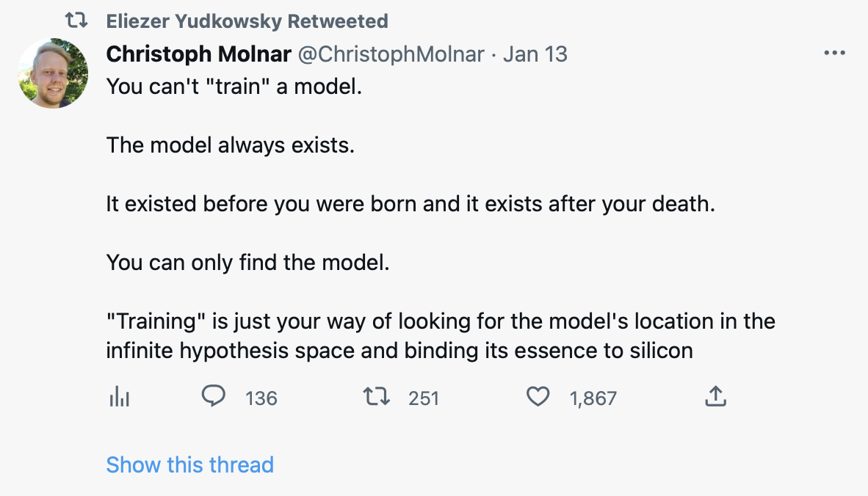

Slide 267
Necessary Assumptions
For supervised learning to be possible to begin with, the environment that produces training samples must be governed by strict natural laws that can be encoded with at most as many bits than there are in training samples
Combinatorially, this rules out most of the possible worlds, leaving only an infinitesimally small fraction of those possible worlds as candidates
Most things that would theoretically be possible, must be actually impossible in the environment whose behaviour we are trying to model
Otherwise, generalization is impossible (barring astronomical luck far too unlikely to bet anything valuable on)

Slide 268
Learning the Laws of the Environment
The model is not supposed to learn to imitate the training samples, but the implicitly imitate the laws of the environment that produced them
Performance is not measured on training samples, but on unseen situations
The training samples are just fleeting shadows of this deeper reality
The model that the learning algorithm constructs from training samples should somehow implicitly model the underlying laws of environment
The model does not necessarily contain explicit knowledge of these laws, but especially in connectionist models, this knowledge is organic and emergent

Slide 269
Supervised Learning Algorithms
Decision trees
Perceptrons
Neural networks (feedforward, recursive, convolutional, deep learning, etc.)
Support vector machines
k-nearest neighbours
Naive Bayes classifier
(and many others...)
All of these are basically one-liners in scikits-learn or Mathematica

Slide 270
Train Hard, Fight Easy
For most learning algorithms, training the model is typically the computationally expensive part
Fortunately, this training needs to be done only once, and then the same model can be used to make any number of decisions
Once trained, the model can choose the action in arbitrary situations by executing it with the situation given to that model as input
Evaluation of a decision tree or neural network for the given input instance is basically just one or two while- or for-loops

Slide 271
Confusion Matrix Example
Describes the false and true positives and negatives of a classifier
Example with 100 positive and 100 negative training examples
Important if costs of false positives and false negatives are wildly different, determining which way we adjust the errors of classifier
 | Predict Positive | Predict Negative
True Positive | 97 | 3
True Negative | 8 | 92

Slide 272
Occam's Razor
Occam's Razor is the observation that from multiple hypothesis that fit the same training examples, the finger-quotes "simplest" one is the best
Do not multiply entities and assumptions needlessly, but only when the training data doesn't fit your current assumptions
However, what constitutes the "simplest" model depends on the assumptions that you make about the world that produces the discrete training examples
Example: fitting a polynomial into the given set of data points, versus fitting a sum of sine curves (Fourier transform) into those data points

Slide 273
No Free Lunch Theorem for Classifiers
Given the same training examples, different learning algorithms produce different models to fit those training examples
No Free Lunch Theorem says that over all possible worlds, every learning algorithm is equally good on average!
Given the same training data with inputs X_{i} and their expected answers, whenever two models disagree on some previous unseen input, one wins in exactly half of the possible worlds, the other wins in the other half
If an algorithm performs well in some class of problems, then it necessarily must pay for this by degraded performance on other problems

Slide 274
Sample Error and True Error
Once trained, the model can be used to classify any input
Sample error is the probability that the model gives a wrong answer for input that was given to it as a training sample
With enough internal degrees of freedom, model can essentially encode all training samples into some kind of lookup table and have zero sample error
True error is the probability that the model gives a wrong answer for a randomly chosen input among all possible inputs
Want to minimize the true error, not the sample error

Slide 275
Bias
The same training data that be generalized in infinitely many different ways
Given the same training data, different learning algorithms produce different models that will disagree on unseen inputs
The tendency to choose one among all possible fitting answers is called the bias of that learning algorithm
Given the same training samples, two learning algorithms produce a different hypothesis and explanation depending on their background assumptions
Training data itself cannot be used to distinguish who is "correct"

Slide 276
Variance
Suppose we split the training data in two, and train two separate classifiers independently using the same learning algorithm
The variance of the learning algorithm is the measure of how often these two classifiers disagree with each other on their classifications on unseen inputs
Measures how sensitive the learning algorithm is for quirks of training data
Bias and variance in learning algorithms are on a continuum akin to Scylla and Charybdis: attempt to decrease one automatically increases the other

Slide 277
Models Should Be Smaller Than Training Data
Given enough internal degrees of freedom, any learning algorithm can implicitly build a lookup table of the training samples given to it
Generalization abilities of such a model are essentially random
For generalization to be possible, the world must be governed by laws that can be expressed using fewer bits of information than training samples
Model should somehow capture these laws, not the random training data
A model with a small error that can be encoded in far fewer bits of information than used for training samples necessarily captures something essential about the world being modelled

Slide 278
Two Extreme Classifier Algorithms
Consider learning algorithm we can call "Closed World Assumption"
Tabulate training data, but for all other inputs, always return false
By No Free Lunch theorem, as good as any other learning algorithm!
CWA algorithm has maximum bias, but zero variance
Consider then another learning algorithm we can call "Coin Flip" that tabulates training data, and for unseen inputs, just flips a coin (w/ caching)
Again, as good as any other learning algorithm over all possible worlds!
CF algorithm has maximum variance, but minimum bias
All classifier algorithms fall somewhere between these two

Slide 279
Hyperparameters
The learning algorithm itself adjusts its internal model based on training data
For example, weights of a neural network
These variables that the algorithm itself adjusts are its parameters
Hyperparameters are parameters that control the learning algorithm itself
For example, the number of nodes in the neural network, or the number of nodes allowed when building a decision tree
Hyperparameter optimization is a dark art in machine learning
Can use cross-validation to increase hyperparameters until performance on validation set decreases

Slide 280
Training, Validation and Test Data
Training examples given by the instructor are divided in three groups:
Training data, validation data, and test data
Training data is used to create and polish the model
Validation data is used to prevent overfitting of the model
As we saw from previous two extreme learning algorithms, fitting the training data 100% means nothing, since the learning algorithm is supposed to generalize the underlying patterns in reality the training data comes from
As soon as model becomes worse on validation data, stop fitting it
Test data is the "final exam" that measures how well model fits reality

Slide 281
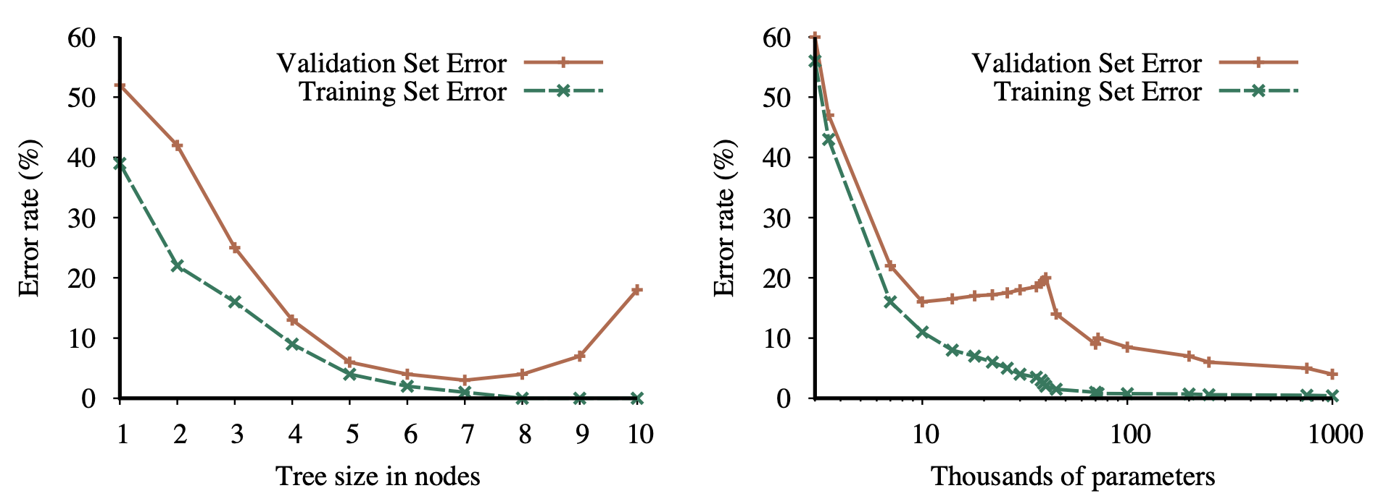
Validation Set Tells Us When To Stop

Slide 282
Ensemble Learning
Instead of trying to create one model, create a bunch of simpler models that individually are not as powerful as the large model
To classify input x, give it to all models and use the majority vote
These simpler models may even constructed with different algorithms
Construction should make the simpler models independent of each other, as there is no point having identical simpler models all return the same answers
When tallying votes for the result, each individual model is given a weight based on how well it operated on the training data

Slide 283
Random Forests
Generalization of decision tree learning to produce an entire forest of small decision trees for an ensemble, instead of a single large tree
Construction of each small decision tree uses the entire training data, but only a randomly chosen handful of possible attributes
This makes the resulting trees more independent of each other
Especially these small trees won't all end up having the same root node!
Individual trees are weak classifiers, but a weighted majority vote over a large number of such trees will classify complex data very accurately

Slide 284
Boosting
When creating the ensemble of simpler models, it would be nice to have these simpler models have complementing strengths
Attach a weight to each training sample, initially all weights are 1
After training each simpler model, adjust the weight of the training samples based on whether that model classified that training sample correctly
Training samples that were classified incorrectly see their weights increased, whereas correctly classified samples see their weights decreased
The simpler model constructed next will have strengths complementing the current model, instead of being yet another yes-man

Slide 285
k-Nearest Neighbours
Learning algorithm that works well assuming that the correct classifications change smoothly in the space of possible inputs
Preprocess the the training data and store it in some geometric data structure
To classify the given input x, find its k nearest neighbours in training data, then use majority vote among those neighbours
Simplest when k = 1, classify as its nearest neighbour
You should normalize multidimensional data among each dimension
Replace each numerical component with how many standard deviations away the point is from the mean value of that dimension
Preprocessing can eliminate redundant training data points

Slide 286
Naive Bayes Classifier
A simplified Bayes network where the true classification C is the root node, and evidence variables from X₁ to X_{n} are its children
Compute P(C | X₁ ∧ ... ∧ X_{n}) = P(X₁ ∧ ... ∧ X_{n} | C) P(C) / P(X₁ ∧ ... ∧ X_{n})
Simplify the formula with the naive assumption that all X_{i} are mutually conditionally independent given C, even though they really are not
Right side becomes P(X₁ | C) * ... * P(X_{n} | C) P(C) / P(X₁ ∧ ... ∧ X_{n})
Get rid of normalization factor P(X₁ ∧ ... ∧ X_{n}) same way as before by marginalizing over all possible classifications C

Slide 287
Estimating Probabilities for a Naive Bayes Model
Instead of building an entire Bayesian network, Naive Bayes only needs to build two tables for the entries P(C) and P(X_{i} | C)
This is trivial nested loops over the set of training samples, as opposed to exponential complexity of building the entire full Bayes network
Estimate each P(X_{i} | C) as N(X_{i} ∧ C) / N(C), and each P(C) as N(C) / N
What if N(X_{i} ∧ C) = 0, thus making every P(C | X₁ ∧ ... ∧ X_{n}) = 0 for such X_{i} ?
Good illustration of Cromwell rule; no real world probability is ever zero
Laplace smoothing estimates P(X_{i} | C) as (N(X_{i} ∧ C) + 1) / (N(C) + 2), as if we had initially seen one more example both ways

Slide 288
Naive Bayes Doesn't Care About Missing Data
In practice, this approach works better than it kinda should
Even better, given a set of training data with many of the individual X_{i} values are missing, a Naive Bayes Classifier can still be constructed from that data
Other learning algorithms can't do much with such data
In this day and age, our online presence leaks all kinds of simple X_{i} about our lives, tastes and opinions
Each X_{i} is individually harmless, but knowing a good subset of them makes Naive Bayes classifiers super efficient in predicting all kinds of C about you

Slide 289
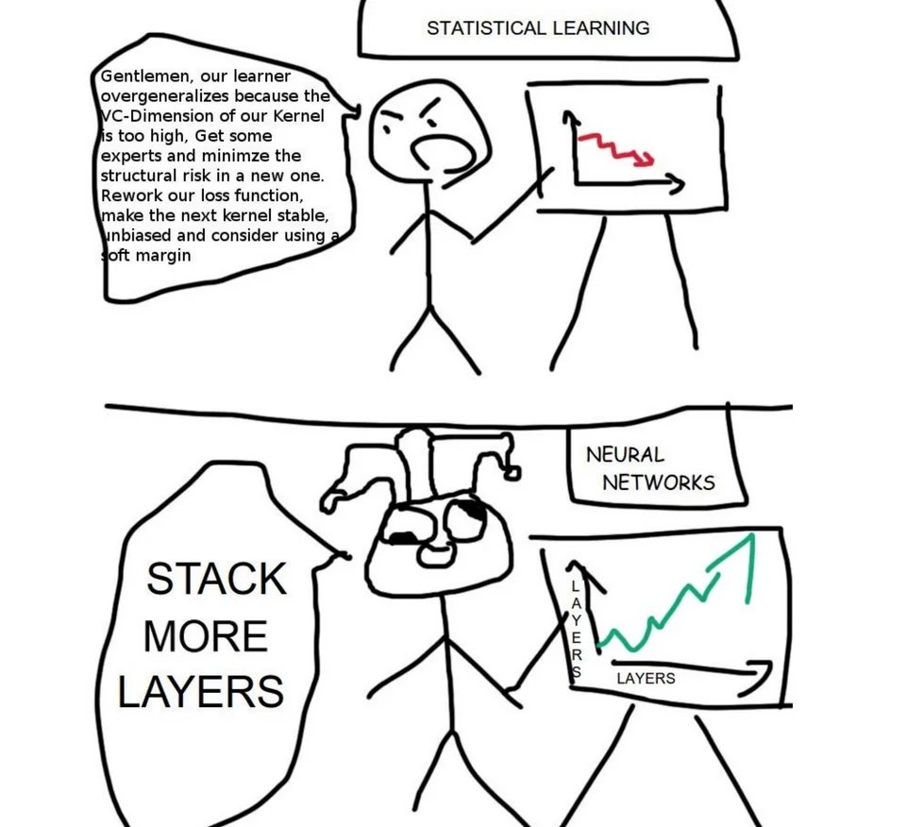

Slide 290
"Look, I remember when AI used to involve math, maybe not Actual Mathematician Math, but at least nontrivial computer science. Modern deep learning is calculus for bright eleven-year-olds, plus the first five pages of a linear algebra textbook, plus a six-month apprenticeship in incompressible alchemical best practices whose lack of principled rationale also deprives them of relevance to macroscopic issues, plus having a billion dollars to spend on training runs."
– Eliezer Yudkowsky

Slide 291
Machine Learning Theory
A learning algorithm constructs a hypothesis h based on its training data
Assume the set of possible hypotheses H from which the algorithm returns one hypothesis based on its training data
Any hypothesis that is seriously wrong will be revealed with high probability after a small number of training data
A hypothesis h is approximately correct if its true error rate is less than ε, for some suitably small value of ε
How many training samples N do we need to ensure that the generated classifier h is approximately correct in this sense?

Slide 292
PAC Learning
Valiant: Assuming statistically independent training data, for the probability of classifier to be ε–approximately correct to be at least 1 – δ, the number of training samples N needs to be at least N ≥ (–ln δ + ln |H|) / ε
Depends on desired error rate ε, success probability 1 – δ, and number of possible hypotheses |H| that the algorithm can generate
Once the hypothesis classifies perfectly this many independent training samples, the smart money bets that this wasn't just a fluke, but similar performance within ε will continue with probability 1 – δ

Slide 293
Module 12: Reinforcement Learning

Slide 294
Markov Decision Problems
Fully observable state space with nondeterministic actions
Transition model T(s, a, s') gives the probability for the system ending up in state s' when performing the action a in state s
No goal states, instead each transition has a reward R(s, a, s')
Common special case of reward per state as R(s, a, s') = R(s')
Negative rewards are penalties
State space may be episodic so that some states are terminal
State space may contain loops and allow infinite traversal

Slide 295
Example: (Simplified) Blackjack
A one-player game that can be modelled as a Markov Decision Process
State consists of sum of player's cards (all face cards are tens, aces are either 1 or 11), along with whether the sum is soft or hard, along with dealer's visible upcard
Same as in all games, state space is a directed acyclic graph without loops
Try to get as close to 21 as you can without going bust
Two actions "hit" and "stay" leading to the next state
Both actions are nondeterministic (nature makes moves for dealer)
Terminal state determines the reward or penalty

Slide 296
Policies
Because of nondeterminism, we can't just pre-plan path through the state space to maximize sum of rewards along the way
Instead, design a policy 𝛑 that associates to each state s the action 𝛑(s) that the agent will perform when finding itself in that state
In Markovian environments where history of reaching the state doesn't matter, policy can be deterministic and depend on current state alone
In fully observable environments, presence of other agents doesn't affect this
In partially observable environments playing against other agents, policies should by randomized with bluffs and slowplays

Slide 297
Example: Optimal Blackjack Policy
Actual blackjack as played in casinos
Also moves "double down" and "surrender"
Policy gives optimal move in each situation
Don't need to give action values or probabilities
Those don't affect the actual move selection
Don't need to explain how much better the chosen action is compared to alternatives

Slide 298
Discounting Rewards
Episodic state spaces such as Blackjack are simple enough, but what about state spaces with loops that allow a potentially infinite sum of rewards?
Must be able to meaningfully distinguish between policy that gains one dollar per minute, versus policy that gains one dollar per year
Can compare average reward of policy per finite time unit
Better solution to introduce discounting factor 𝛾 (gamma) in range [0, 1]
Reward r gained k steps to the future is worth only 𝛾^{k}r
This works out nicely with Bellman equations

Slide 299
State Utilities
Once policy 𝛑 is fixed, each state has utility U_{𝛑}(s), or just U(s)
The utility U_{𝛑}(s) of the given state s is the expected sum of rewards by following the policy 𝛑 starting from that state
State utilities are connected to each other with Bellman equation U(s) = max_{a} ∑_{s'} T(s, a, s') (R(s, a, s') + 𝛾 U(s'))
Says that the utility of the state equals its local reward, plus the discounted rewards starting from the successor state after best action

Slide 300
Q-values
Alternative, sometimes more convenient way to express utilities
Instead of utility of state s, associate utility to state-action pair (s, a)
Q(s, a) is the expected utility starting from state s with action a
Rewriting the previous Bellman equation, we get Q from either U or Q: Q(s, a) = ∑_{s'} T(s, a, s') (R(s, a, s') + 𝛾 U(s')) = ∑_{s'} T(s, a, s') (R(s, a, s') + 𝛾 max_{a'} Q(s', a'))

Slide 301
Connecting U, Q, and Optimal Policy 𝛑*
Once Q-values are known, U-values are trivial to extract: U(s) = max_{a} Q(s, a)
Q-values can be used to determine the optimal policy 𝛑*: 𝛑*(s) = argmax_{a} Q(s, a) In state s, optimal policy uses action a that maximizes Q(s, a)

Slide 302
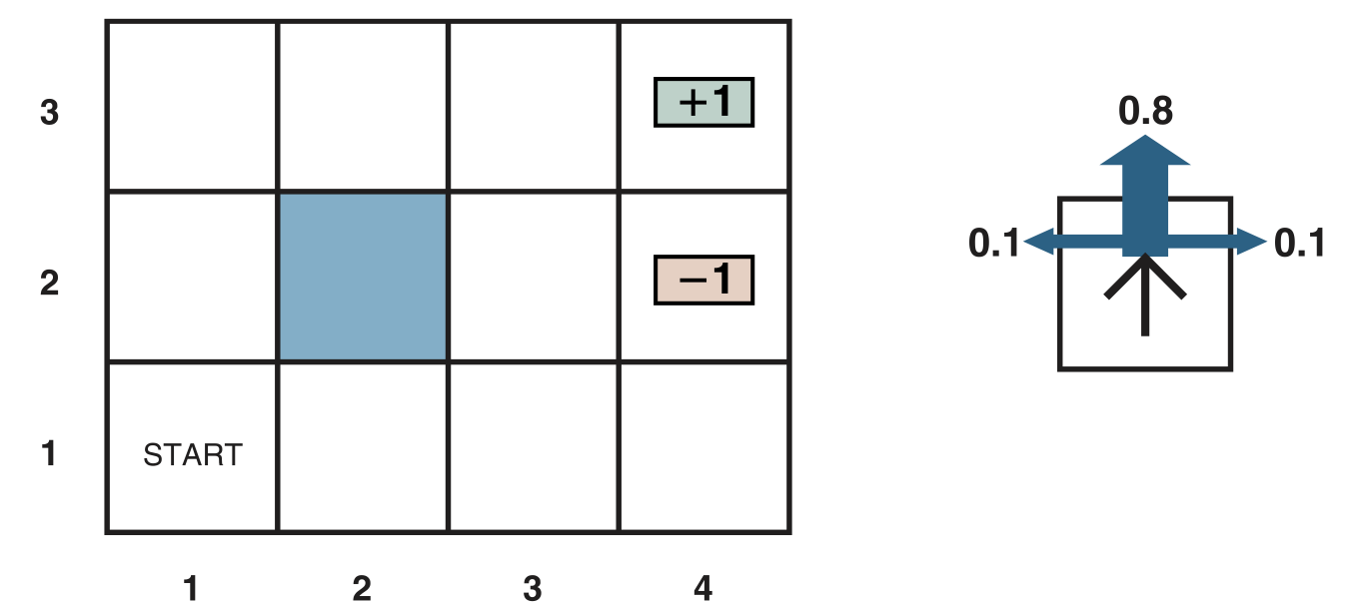
Example: GridWorld

Slide 303
Okay, So How To Solve U, Q, and 𝛑* ?
The optimal policy 𝛑* is sufficient for optimal action
We don't need to know how much better some action is compared to other actions to be able to execute that action
Need to solve the set of equations either for U or Q
For n states and b actions, U has n unknowns, Q has nb
Equations look like linear equations, but unfortunately are not, due to the presence of the max operator
We can't solve this directly as a system of linear equations

Slide 304
Dynamic Programming
If the state space is known to be a directed acyclic graph (no loops), utility values U(s) can be tabulated in a "bottom up" dynamic programming fashion
For example, basic strategy table in Blackjack
Sort the states in some topological order so that if there is a possible transition from state s to state s', the state s' is processed before state s
Loop through all states in this topological order
When the loop arrives at state s, the utility U(s') for all its possible successor states s' has already been computed in previous rounds
Can now compute U(s) on the spot from Bellman equation

Slide 305
Value Iteration
Solve the n unknowns U(s) together in an iterative fashion
Initialize each utility estimate U₀(s) to zero
Use the current set of U_{i}(s) values to compute new values U_{i+1}(s) using the modified Bellman update equation U_{i+1}(s) = max_{a} ∑_{s'} T(s, a, s') (R(s, a, s') + 𝛾 U_{i}(s'))
Repeat until convergence

Slide 306
Value Iteration Convergence
It can be proven that previous equations will converge to actual state utilities that satisfy the Bellman equations
However, for tricky state spaces, value iteration may need an exponential number of steps to converge, even after the implied policy is optimal
The essential problem is that this method implicitly computes the exact action values Q(s, a) for all states s and actions a
However, recall that when an action a is known to be better than action b in the same state, we don't need to know how much better it is!
This redundant knowledge doesn't affect optimal policy 𝛑*

Slide 307
Evaluating Utilities With A Fixed Policy
Suppose the policy 𝛑 is fixed to something
Calculate the utilities U_{𝛑}(s) for each state assuming that fixed policy
Under assumption of fixed policy, Bellman equations become linear! U(s) = ∑_{s'} T(s, 𝛑(s), s') (R(s, 𝛑(s), s') + 𝛾 U(s'))
Recall that T(...) and R(...) are known constants, not functions
Use your favourite linear algebra tool to solve unknowns U(s)

Slide 308
Bellman Updates On Fixed Policies
If we don't happen to have a powerful linear algebra solver at hand, we can still use modified Bellman updates to calculate U_{𝛑}(s) U_{i+1}(s) = ∑_{s'} T(s, 𝛑(s), s') (R(s, 𝛑(s), s') + 𝛾 U_{i}(s'))
As before, these U_{i+1}(s) converge to true utilities U_{𝛑}(s) for that policy 𝛑

Slide 309
Policy Iteration
Faster way to solve for optimal policy directly than value iteration
Algorithm alternates between two stages of policy evaluation and policy improvement, until policy improvement step does not change current policy
Start with any random policy 𝛑₀ that can be anything (usually greedy)
Compute all state utilities U₀(s) assuming the initial policy 𝛑₀
Given utilities U₀(s), compute new policy 𝛑₁ from 𝛑₀ with greedy local updates
Repeat until new policy 𝛑_{i+1} is the same as its previous policy 𝛑_{i}
Can be proven to converge to optimal policy 𝛑*

Slide 310
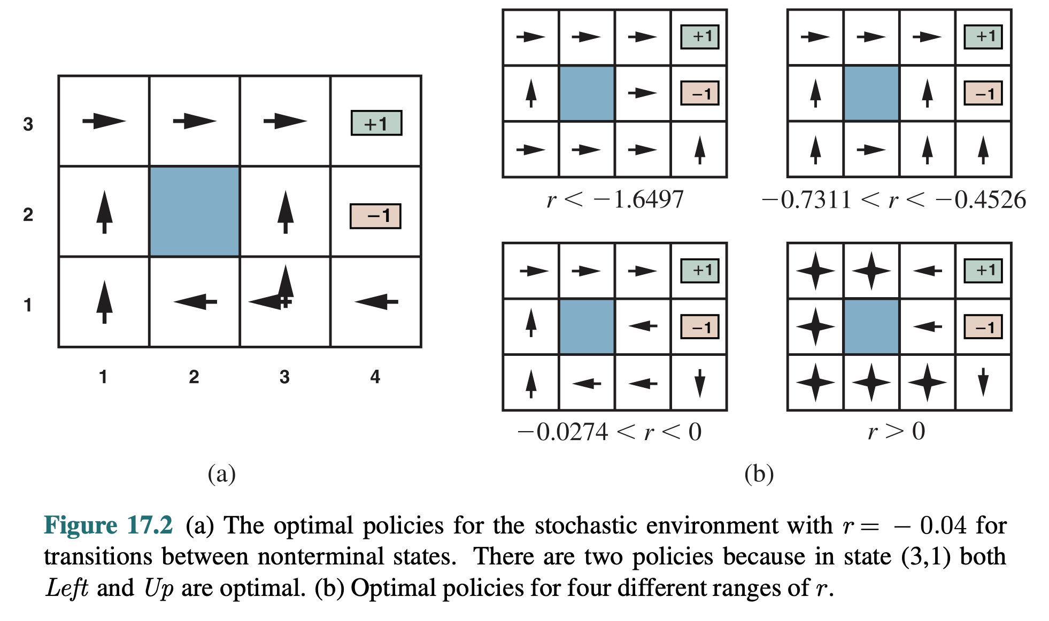
Solutions to GridWorld

Slide 311
Unknown Transitions And Rewards
Previous algorithms assumed that transition probabilities and reward functions T(s, a, s') and R(s, a, s') are fully known
When exploring an unknown environment, this is not necessarily the case
Environment is a black box and only tells us the current state and reward
How can we find a good policy in such environments?
Need repeated exploration to see what happens if we do various things
Instead of trying out an exponential number of possible action sequences, we wish to try out as few sequences as possible and generalize from there

Slide 312
Model–Based Learning
Assuming that we get training samples that are statistically representative of the environment, we can estimate T(s, a, s') and R(s, a, s') from these samples
Given enough training samples, can calculate Q, U and 𝛑* under assumption that estimated probabilities and rewards are true enough
However, this middleman is completely redundant!
When comparing actions, it's unnecessary to know how the value of each action breaks down into sum of probability-weighted reward sequences

Slide 313
Model-Free Learning
In an observable state space, we could just perform many action sequences and tabulate how many times action a led from state s to state s'
As in frequentist probabilities, these counts would converge to T(s, a, s')
However, building such probability model turns out to be a completely redundant middleman who can be eliminated without losing anything!
Model-free reinforcement learning techniques use this information only implicitly, converging to optimal policies without creating any explicit T or R tables along the way

Slide 314
Monte Carlo Policy Evaluation
Given a fixed policy 𝛑, how well does it perform in an unknown environment?
Assume an episodic environment where we get to start at any state
Generate a large number of training samples following the policy 𝛑
After generating training examples, loop through each state s and find all training samples where that state s was encountered
Average the rewards following the state s seen in these training samples, to use as estimate of the actual value U_{𝛑}(s)
When using a large number of training samples, state transitions behave according to the underlying transition probabilities T(s, a, s')

Slide 315
Temporal Difference Learning
Observation: for fixed policy 𝛑, the state utility U_{𝛑}(s) is the weighted average of the utilities its successor states s', plus the transition reward
For each transition from state s to state s' in each training sample, temporal difference learning uses the update formula U_{𝛑}(s) ← U_{𝛑}(s) + ɑ(R(s, 𝛑(s), s') + 𝛾 U_{𝛑}(s') – U_{𝛑}(s))
The parameter ɑ is the (somewhat misnamed) learning rate of TD-algorithm

Slide 316
Active Reinforcement Learning
Previous policy evaluation algorithms are passive in that they don't change the policy during the policy evaluation
Policy changes in the policy improvement stage, to be evaluated again
Active reinforcement learning locally updates the policy as soon as some action value Q(s, a) looks better than Q(s, b) for the previous best action b
Further training samples generated using this updated policy

Slide 317
Exploration vs. Exploitation
Dilemma: when performing a training run, following the current policy does not provide samples for values for other possible actions
A good action that was unlucky in the early training runs never gets a chance to prove its worth, unless the current optimal action value Q(s, a) deteriorates
Must occasionally try out other actions than the current optimal action
However, this can't be done all the time, since otherwise the measured action values will get all out of whack
In each state, ε-greedy algorithms uses the current best action with probability 1– ε, and a random action with small probability ε

Slide 318
Softmax Action Selection
Softmax is an easy way to choose randomly from different actions so that actions that currently seem better have a higher chance of being chosen
Technically, this should be called "soft argmax", instead of "softmax"
Action a whose current value estimate is Q(s, a) is chosen with probability e^{βQ(s, a)} / ∑_{a'} e^{βQ(s, a')}
Starting with β close to zero makes distribution more uniform
Increasing β makes distribution approach true argmax

Slide 319
Temporal Difference Q-Learning
When observing the state transition from state s to state s' when taking the action a, apply the temporal difference update to state-action function: Q(s, a) ← Q(s, a) + ɑ(R(s, a, s') + 𝛾 max_{a'} Q(s', a') – Q(s, a))
For each step, rule looks at all possible actions in successor state
Alternative SARSA rule looks at the action a' actually taken at successor: Q(s, a) ← Q(s, a) + ɑ(R(s, a, s') + 𝛾 Q(s', a') – Q(s, a))

Slide 320
Multistep Temporal Difference
In state spaces where all rewards and penalties come in the end, adjusting Q-values using just one step lookahead makes these values converge slowly
Generalize the temporal difference formula to look k steps ahead
Normal temporal difference special case of this with k = 1
Rewrite the Bellman update formula to adjust Q(s, a) towards the sum of next k rewards plus the value of action taken k steps from the current state
Generalization TD(λ) uses exponentially decaying weights for summing up the rewards ahead in the training sequence
Parameter λ is in range [0, 1], easy update rule

Slide 321
Reward Shaping
Technique analogous to using a heuristic function in A* state space search
Uses background knowledge to speed up searching for the optimal policy
Define a potential function Φ(s) for states to guesstimate how good they are
This potential function should reflect the features of the current state
Instead of transition reward function R(s, a, s'), use R(s, a, s') + 𝛾Φ(s') – Φ(s)
It can be proven that the optimal policy found using such modified rewards will still be optimal under the original reward function
However, the search for optimal policy will now converge faster, assuming that the potential function Φ contains useful information

Slide 322
Generalization in Reinforcement Learning
In astronomically large state spaces (for example, backgammon), it is not possible to explore but an infinitesimal portion of all possible states
Must generalize the knowledge acquired in the visited states to unseen states that are in some sense "similar" to those visited states
Project a complex state into a smaller feature vector
Use a neural network or some other function approximator to estimate the utility of the state based on its feature vector
Temporal difference updates performed as neural network feedback

Slide 323
TD-Gammon
Back in 1992, backgammon player using feedforward neural networks that estimate the state utility as cutoff evaluation in expectimax search
Start with random neural network that surely played pretty comically
Have two copies of such network repeatedly play against each other
After each match, observe the outcome, and use temporal difference updates to adjust the neural network weights closer to the observed outcome
Converged to fixed weights after 1.5 million matches using expert-chosen features, resulting player revolutionized the theory of backgammon

